Slide 1

Server Kit Node.js

Slide 2
Day 1
Principles and architecture of uuAppServer
How to use documentation
uuCMD Controller
DtoIn, DtoOut, uuURI, ucEnv, Mappings.json
uuCMD Abl
Validation
Error handling
Persistence
MongoDB introduction
Copyright © 2016 Unicorn Top Gun Academy

Slide 3
Day 2
Persistence
uuAppObjectStore DAO
Persistence.json
Authentication & Authorization
Session, Profiles.json, AuthorizationResult
Persistence – Binary data
Upload/Download using a predefined set of uuCMDs
uuAppBinaryStore DAO
Copyright © 2016 Unicorn Top Gun Academy

Slide 4
Day 3
uuUve
Logging
uuAppClient
Pagination
uuCloud deployment
Final exercises - uuJokes
Design introduction
Implementation of 2 UCs
Copyright © 2016 Unicorn Top Gun Academy

Slide 5
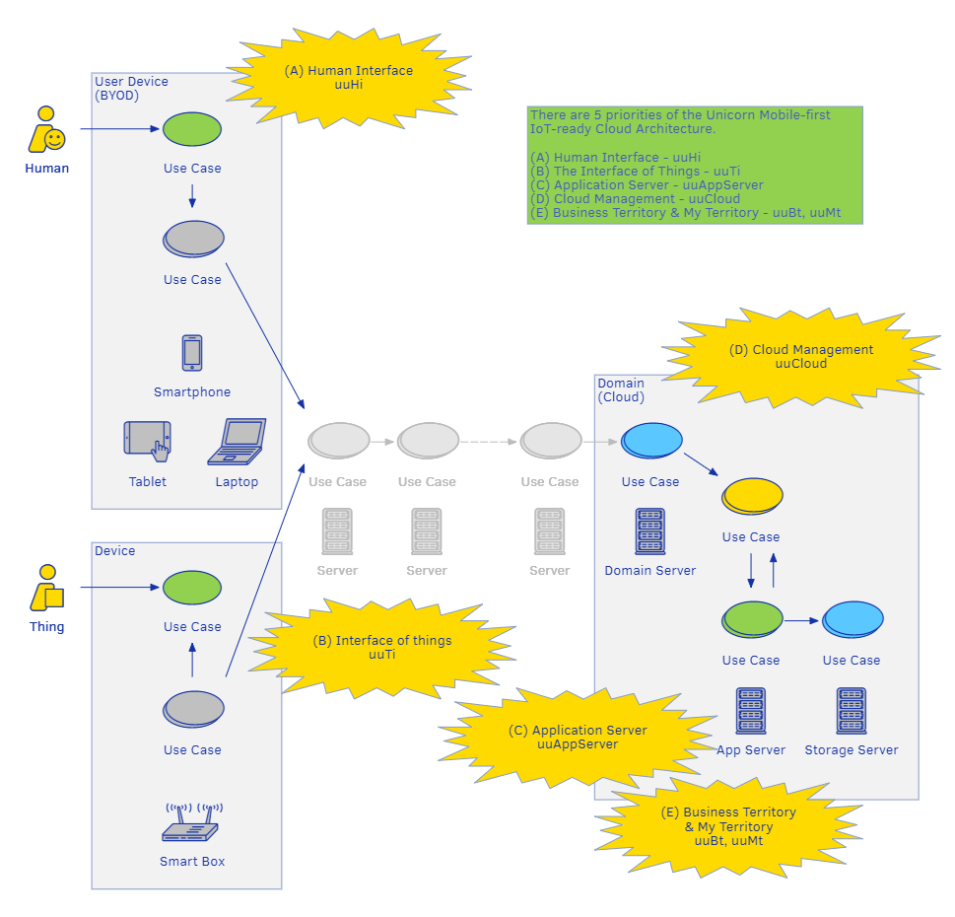
Mobile-First IoT-Ready Cloud Architecture
Copyright © 2016 Unicorn Top Gun Academy
Notes:
Architecture in which developers can focus primarily on functionalities that add value directly, support business processes
Login, multilingualism, where the application runs
Use-Case Driven Approach – application – set of funcs that solves some problems

Slide 6
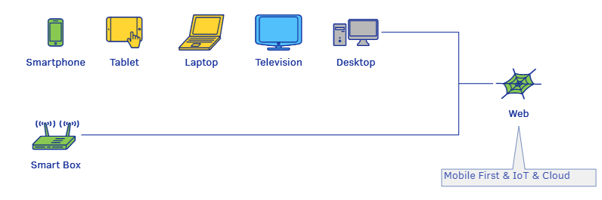
Mobile-First IoT-Ready Cloud Architecture
Mobile-First – ready for mobile and other smart devices
IoT-Ready – ready for Internet of Things
Cloud – deployed to a cloud
Priority
uuHI - graphical user interfaces guideline for different devices
uuTI – how to integrate app with IoT smart devices
uuAppServer – server-side guideline
uuCloud – running applications accessible from anywhere
uuBT and uuMT – Complex information systems for companies and individuals reflecting the organizational structure
Copyright © 2016 Unicorn Top Gun Academy

Slide 7
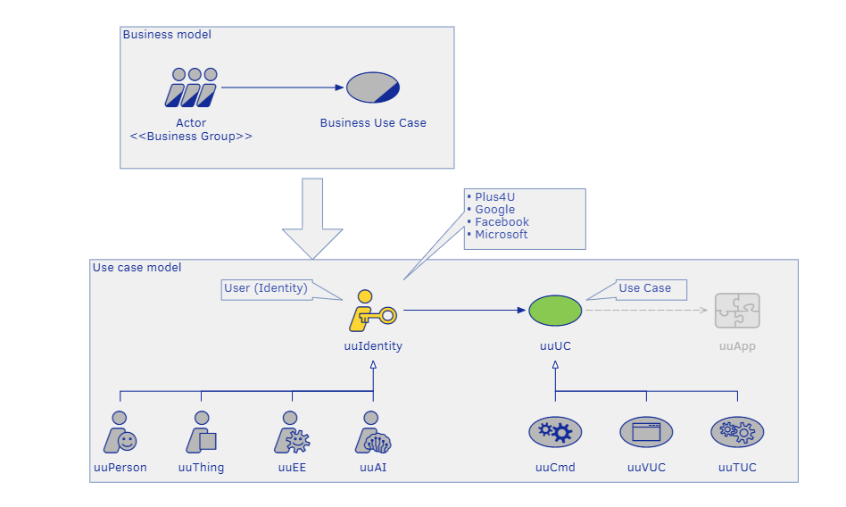
Users and use cases
uuIdentity – identity representing the user who fulfills his needs through the information system
uuUC – use cases, which a user triggers and are executed by a system
Copyright © 2016 Unicorn Top Gun Academy
Notes:
Use-Case Driven Approach – application – set of functionalitines that solves some problems
Identity representing the user, which use it to fulfills his needs isuint information systém

Slide 8
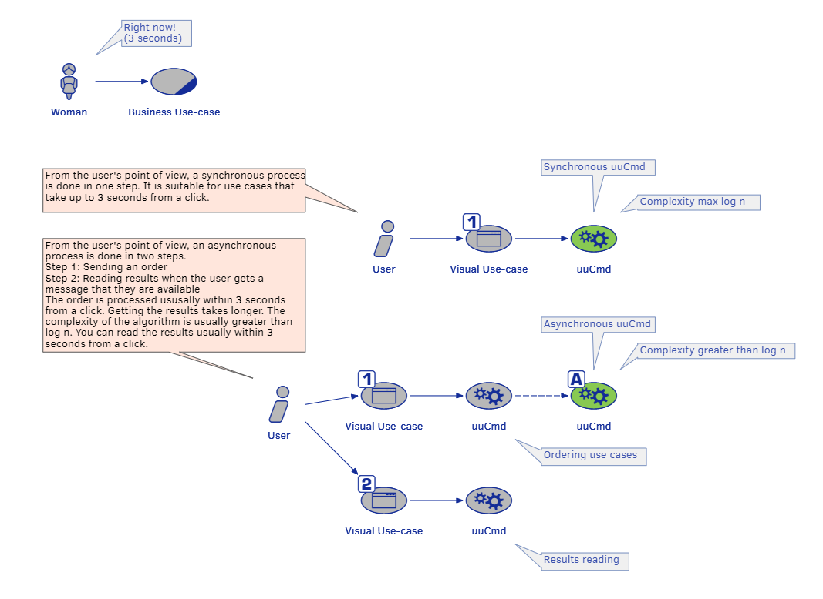
Sync and Async Use cases
Notes:
- Synchronous use case is processed almost immediately. The user does not wait longer than 3 seconds from the click (it is good branch practice).
- Asynchronous use case takes longer to process. The user sends an order to the system and continues in his or her work. The system meanwhile processes the use case and when it is solved, informs the user

Slide 9
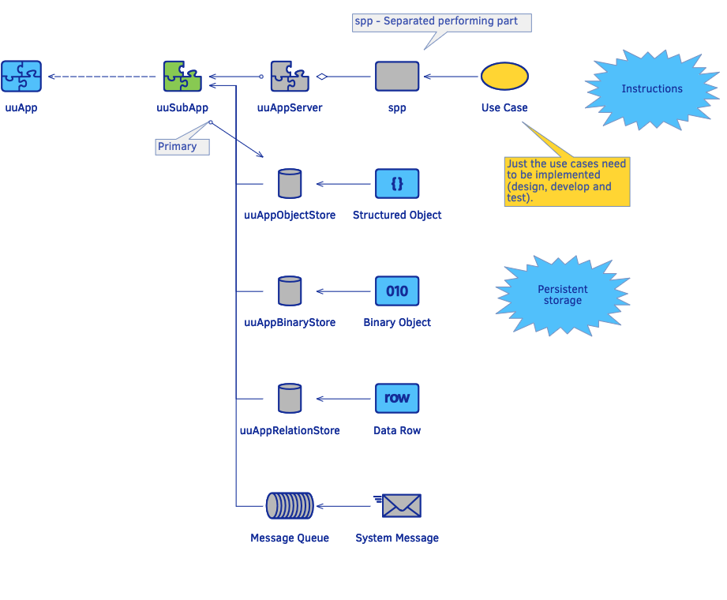
uuApp decomposition
Copyright © 2016 Unicorn Top Gun Academy
Notes:
If a uuApp does not need to be decomposed, still one uuSubApp that is usually called Main is created. Also applies that a default separated performing part (default spp) does not have to be addressed.
Attention!
uuAppServer, uuAppObjectStore and uuAppBinaryStore are standalone logical aggregates. However, in the uuApp architecture,
uuAppObjectStores and uuAppBinaryStores are also libraries of the same name installed on a uuAppServer and therefore only their interface is called, exclusively from a respective uuAppServer. That is the place where a uuApp is programmed – on a uuAppServer.

Slide 10
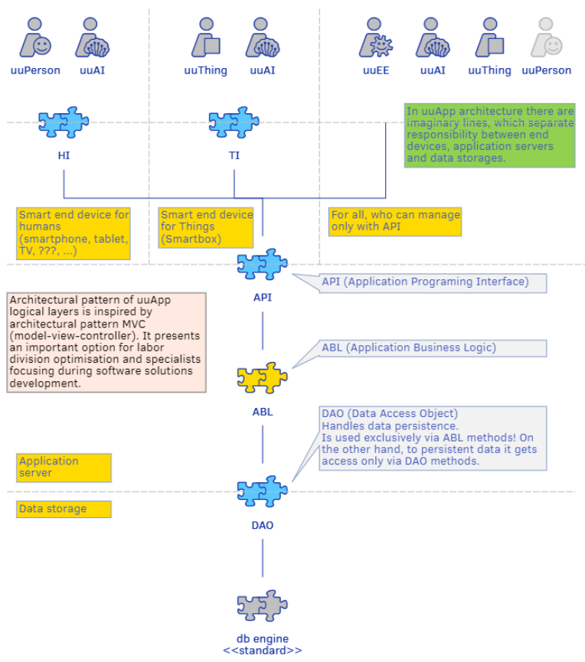
Logical layers
Copyright © 2016 Unicorn Top Gun Academy
Notes:
Similar to the Model-view-Controller (MVC) architecture, uuApp divides the application into the following logical layers:
UI (User Interface) - The user interface layer. The UI layer is further divided into:
HI (Human Interface) - Human user interface layer.
TI (Thing Interface) - IoT user interface layer.
API (Application Programming Interface) - A layer of application programming interface.
ABL (Application Business Logic) - Application logic layer
DAO (Data Access Objects) - Data persistence layer

Slide 11
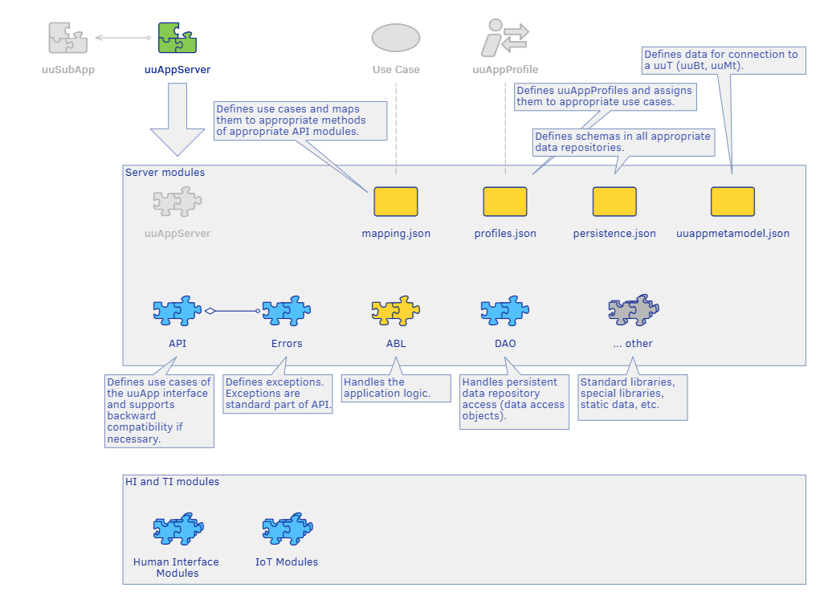
uuAppServer structure
Copyright © 2016 Unicorn Top Gun Academy

Slide 12
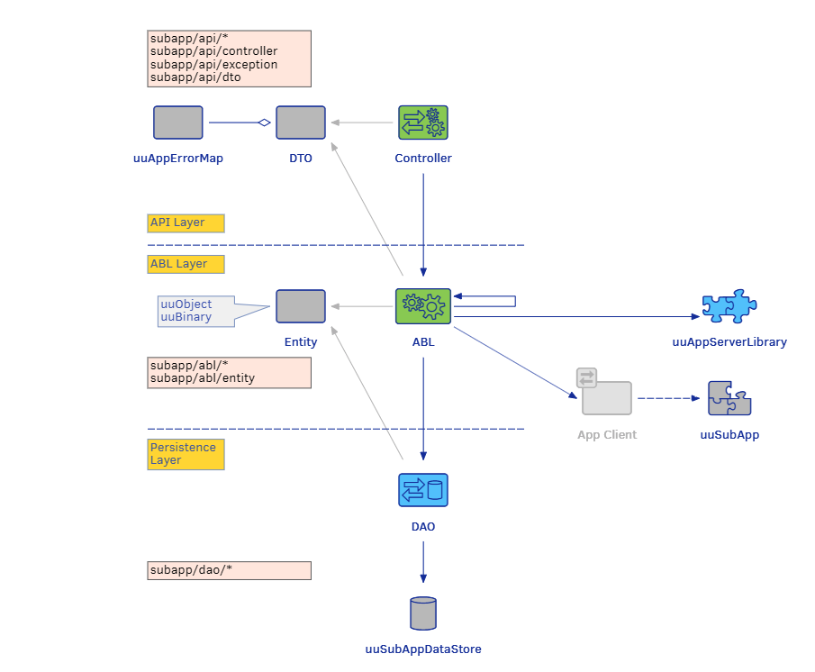
uuAppServer logical layers
Notes:
review the communication between layers in the uuAppServer
also mention that you can call anotheruuSubApp from the ABL using appClient

Slide 13
uuAppServer libraries
standard libraries that are delivered as part of the uuAppServer
uuAppWorkspace - authorization declared by application profiles in profiles.json
uuAppObjectStore - persistence of structured data declared through persistence.json
uuAppBinaryStore - persistence of unstructured data declared through persistence.json
uuAppAuditLog - library for uuUC logging
uuAppStats - library collecting data from uuAuditLog and uuAppWorkspace – dataStoreStats
uuAppDevkit – provides set of tools to support development
uuAppTelemetry - library to work with telemetry data
uuAppMessageBroker – provides uniform interface for messaging
Copyright © 2016 Unicorn Top Gun Academy

Slide 14
Documentation
Technologically independent documentation of uuAppg01Server
Helpdesk | uuKnowledgeBase | Application Server | uuAppg01Server
Documentation of uuAppServer Node.js
Helpdesk | uuKnowledgeBase | Application Server | uuAppg01Server - NodeJS
Structure
Get Started – Essential Examples
Deployment, Operation
Development Environment
HowTo
Components
Release Notes
Copyright © 2016 Unicorn Top Gun Academy
Notes:
Students should be able to find most of the information on their own, because there wont be a lector during the development

Slide 15
Exercise 0 – Preparing environment
Prepare a development environment for uuAppServer - Node.js Documentation | Development Environment | Preparing Environment
Installation of Node.js, MongoDB, IDE and GIT configuration
Configure npm registry
npm config set registry https://repo.plus4u.net/repository/npm/
Create new uuApp Node.js project
Create new folder uu_jokes_maing01
Open the folder and execute in terminal: npx create-uuapp
npx = NPM package runner (install package and invoke it)
Open the project in your IDE and go through the generated structure
Start the server
cd uu_jokes_maing01-server
npm start
Open the demo page In your browser
Copyright © 2016 Unicorn Top Gun Academy
Notes:
check the project structure together

Slide 16
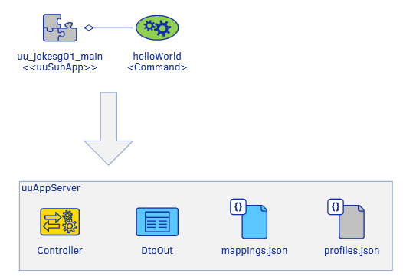
Let’s get started – first uuCMD
Copyright © 2016 Unicorn Top Gun Academy

Slide 17
Controller
Located in <%sub-app%>/app/api/controllers
Controller methods have a predefined structure with one parameter ucEnv (Use Case Environment) – will be described later
Methods must return an object (dtoOut)
dtoOut must be always returned and contain an object uuAppErrorMap
It does not contain business logic, so it usually only calls the methods of the Abl and modify the input for it
Singleton
Copyright © 2016 Unicorn Top Gun Academy

Slide 18
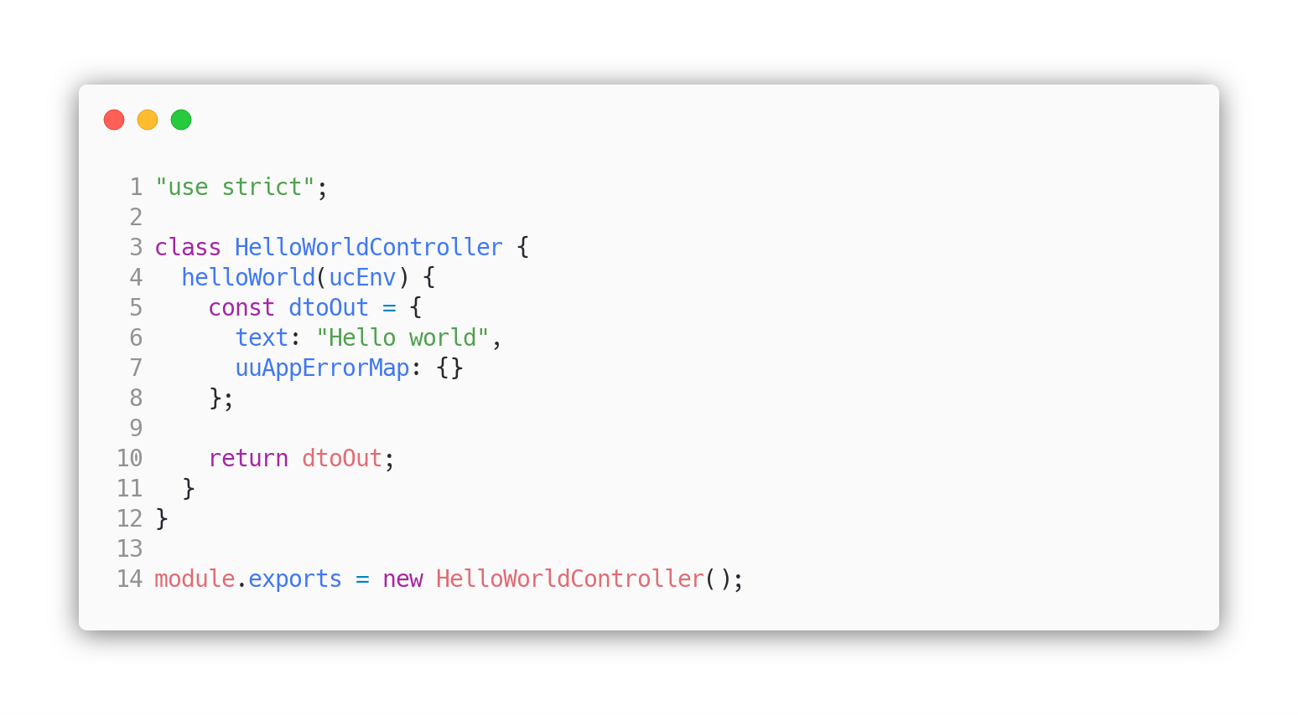
Controller
<%sub-app%>/app/controllers/hello-world-controller.js
Copyright © 2016 Unicorn Top Gun Academy

Slide 19
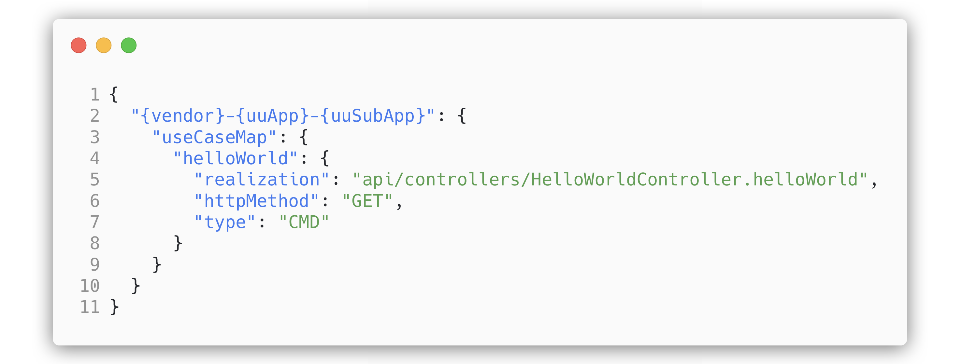
Mappings.json
A structure defining individual use cases and their mapping to the respective methods of the appropriate controllers
from the URL to the methods
realization refers to the appropriate controller
in the following format: api/controllers/<ClassNameControlleru>.<methodName>
POST vs GET
WARNING: Class name must be based on the file name.
However, according to convention:
File name: kebab-case (hello-world-controller.js)
Class name: PascalCase (HelloWorldController)
Method name: camelCase (helloWorld)
<%sub-app%>/app/config/mappings.json
Copyright © 2016 Unicorn Top Gun Academy
Notes:
However, according to convention, a different case is used.

Slide 20
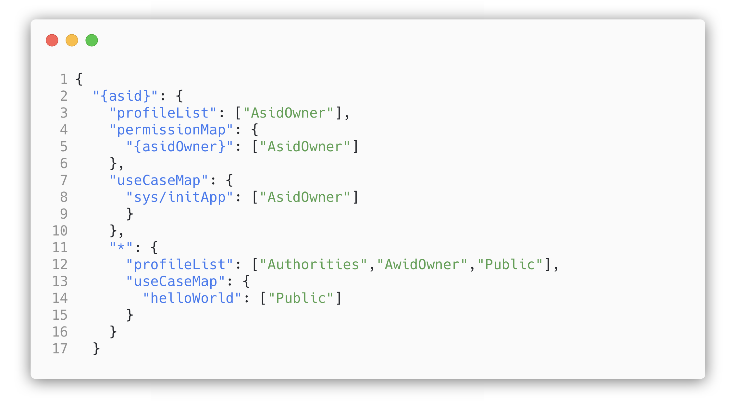
Profiles.json
Structure defining uuAppProfiles and their assignment to relevant use cases
Endpoints with profile „Public“, are not authorized
How to use and configure your own profiles will be explained as part of the Authentication & Authorization process
<%sub-app%>/app/config/profiles.json
Copyright © 2016 Unicorn Top Gun Academy

Slide 21

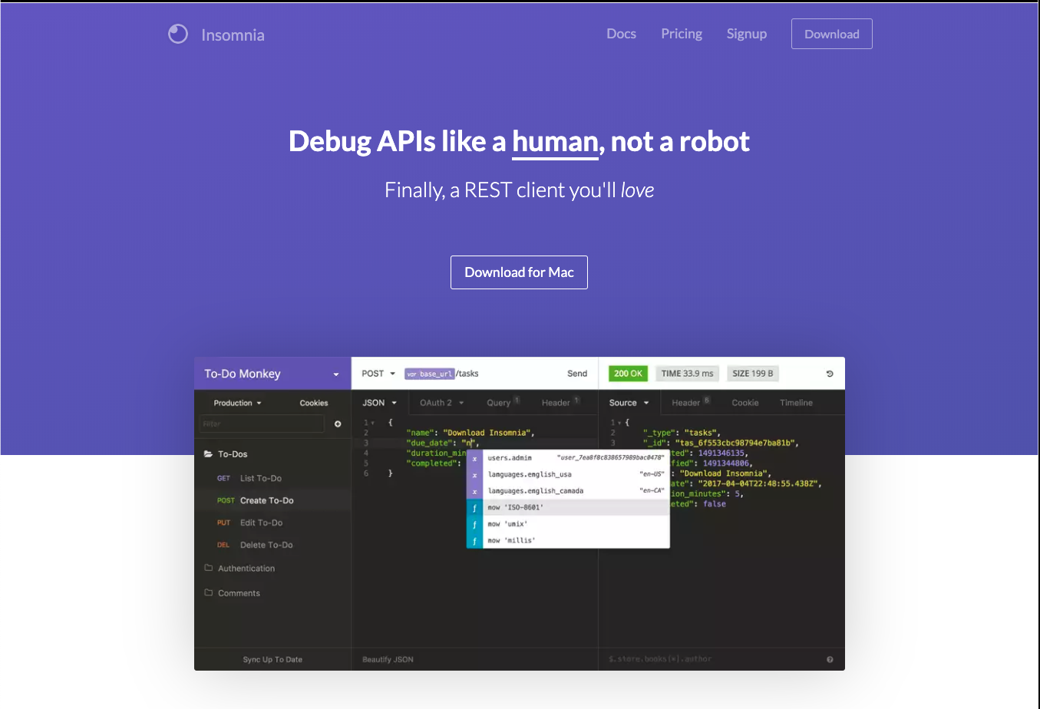
REST Client
Insomnia
Postman

Slide 22
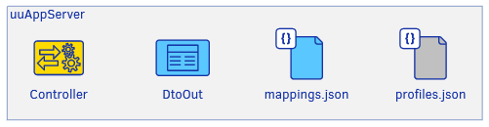
Exercise 1 - HelloWorld
Implement uuCMD helloWorld that returns a greeting and current time.
To simplify the exercise, turn of the persistence
It disable a server functionality that would require configuration / authorization, runtime mode etc.
app/config/persistence.json, change to: { "uuSubAppDataStore": null }
Implement uuCMD helloWorld
Controller, mappings.json, profiles.json
Start server (npm start)
Call the new endpoint
http://localhost:8080/uu-jokes-maing01/0/helloWorld
Copyright © 2016 Unicorn Top Gun Academy
Notes:
do some change to demonstrate the nodemon which restarts the server after the change
show them how to run the uuAppServer in debug mode – they should be able to stop the execution at the controller before the dtoOut is returned

Slide 23
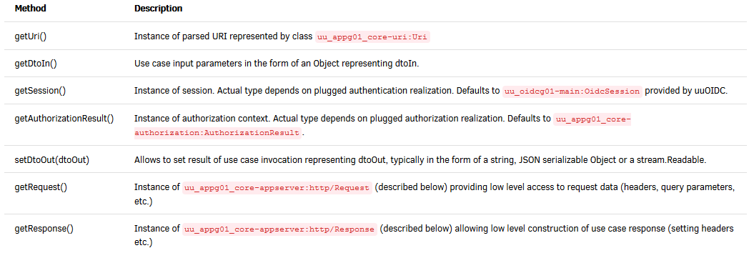
Use Case Environment
Use Case Environment (ucEnv) provides technology independent API
For example it provides URI, data input (dtoIn), session, authorization result, request and reponse objects, etc
uuAppServer-Node.js Dokumentace: Components |uuAppServer
Copyright © 2016 Unicorn Top Gun Academy

Slide 24
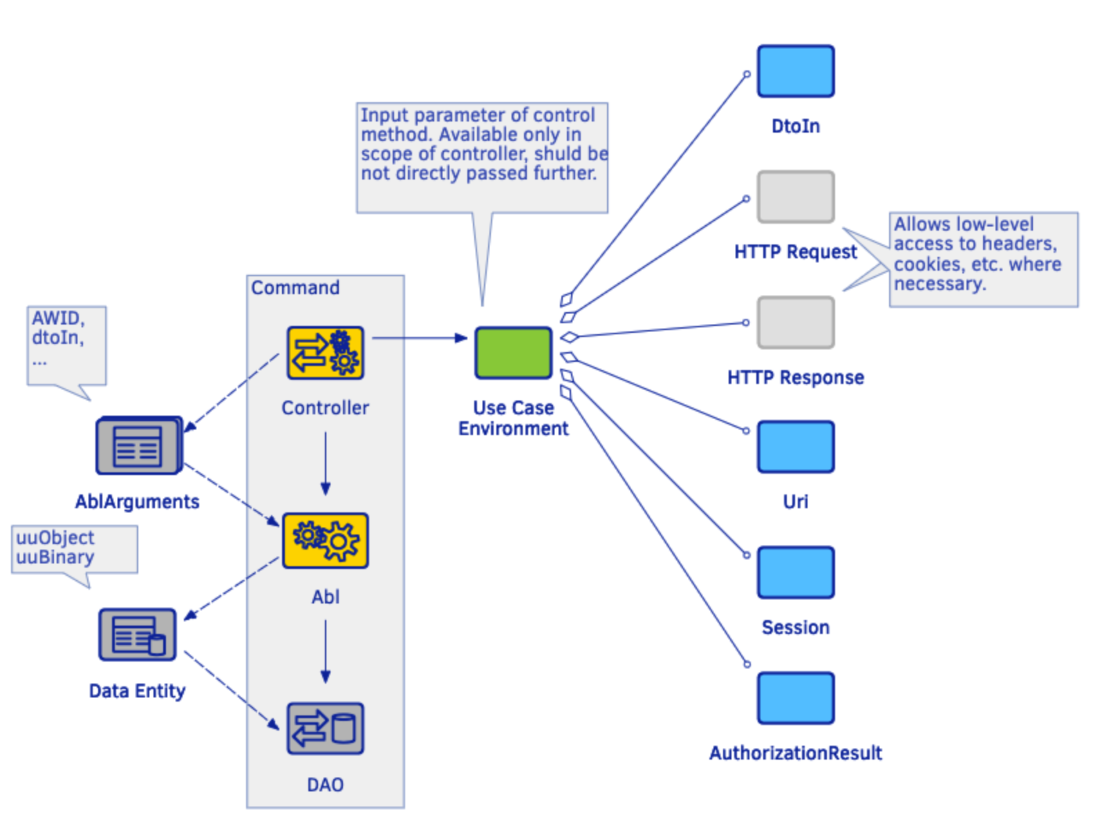
Use Case Environment - flow
Notes:
- image to understand the flow

Slide 25
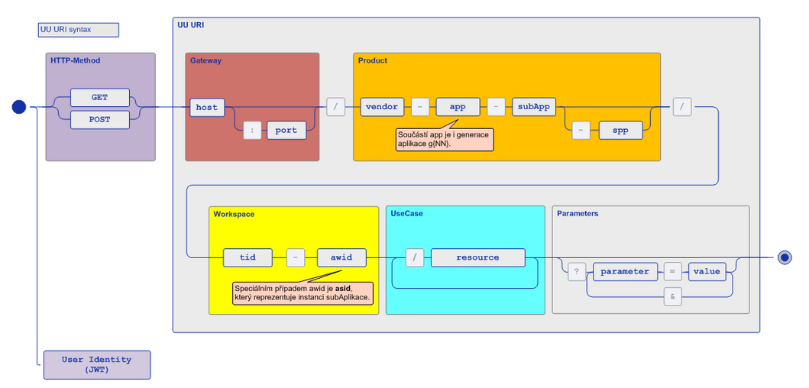
uuUri
It allows addressing of particular uuApp functionality
https://{gateway}/{vendor}-{app}-{uuSubApp}/ {asid|awid}/{uuUc}?{params}
https://uuos9.plus4u.net/uu-dockitg01-main/2590bf997d264d959b9d6a88ee1d0ff5/book/page?code=example0
uuAppServer-Node.js Documentation: Components |Routing
Copyright © 2016 Unicorn Top Gun Academy

Slide 26
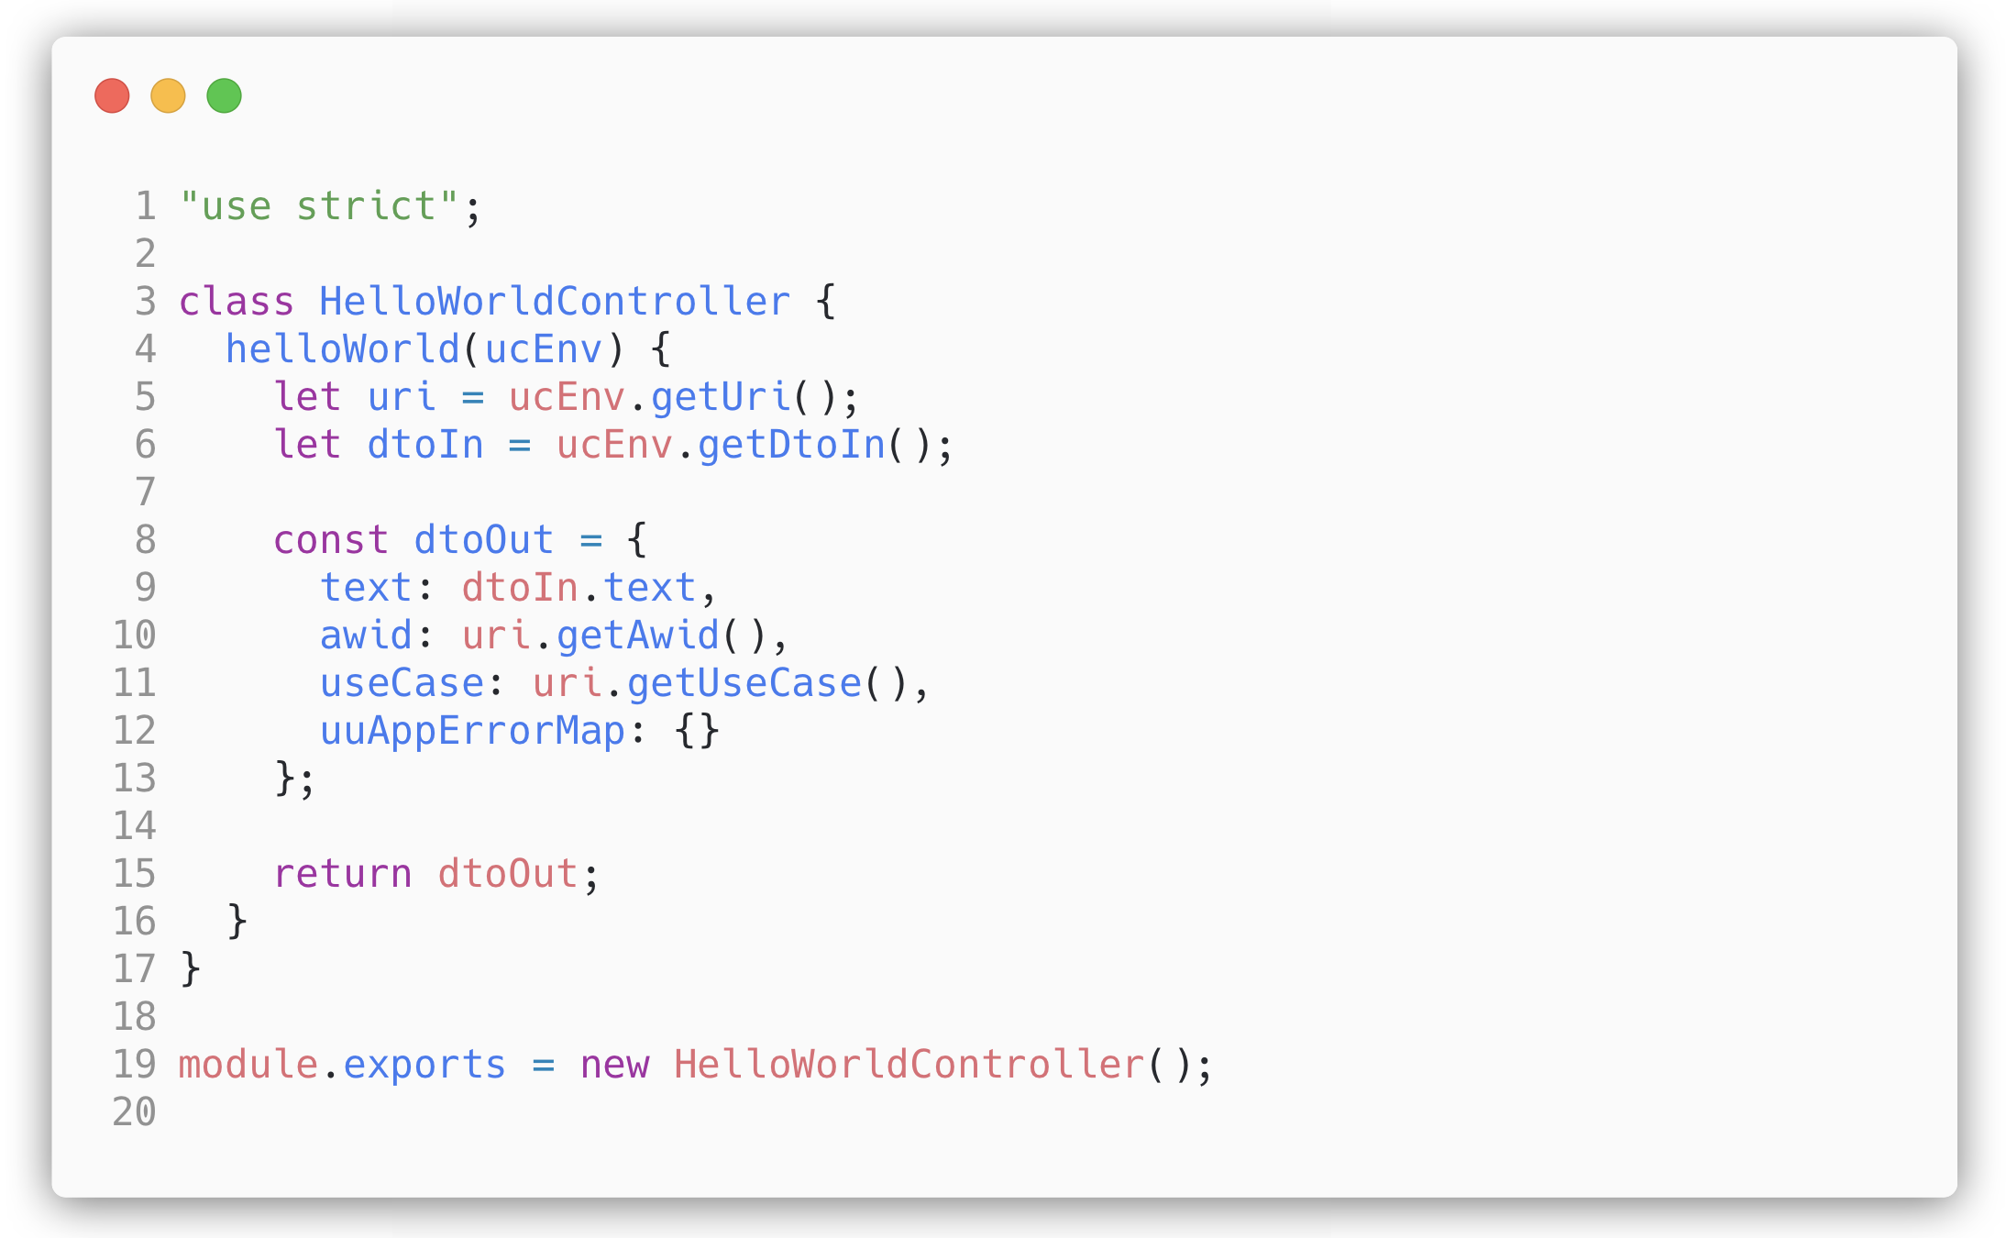
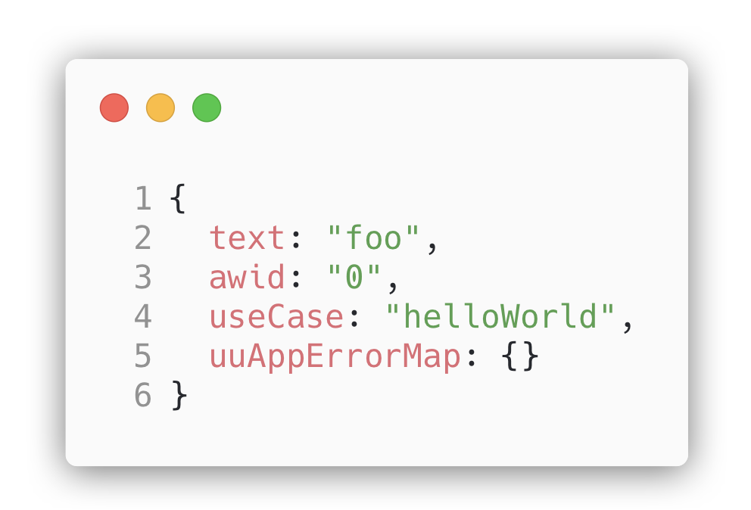
Controller – usage of ucEnv, uuUri, DtoIn
localhost:8080/uu-jokes-maing01/0/helloWorld?text=foo
Copyright © 2016 Unicorn Top Gun Academy

Slide 27
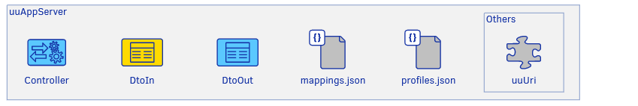
Exercise 2 – dtoIn, uuUri
Implement a POST command joke/create
Load joke param from the dtoIn and return as part of the dtoOut
Also return the information from the current uuUri
product, awid and useCase
Start the server and execute appropriate endpoint (uuCmd)
Copyright © 2016 Unicorn Top Gun Academy

Slide 28
Testing
Tests are located in <%sub-app%>/test/
File name must be in format .test.js, for example. joke.test.js
Run tests using the terminal command npm test
Eventually npm test -- testName (for example. npm test -- joke)
uuAppServer uses the Jest library internally for testing.
It is possible to use functions like beforeAll, beforeEach, afterAll
Expect (https://facebook.github.io/jest/docs/en/expect.html)
uu_appg01_server-test
Copyright © 2016 Unicorn Top Gun Academy

Slide 29
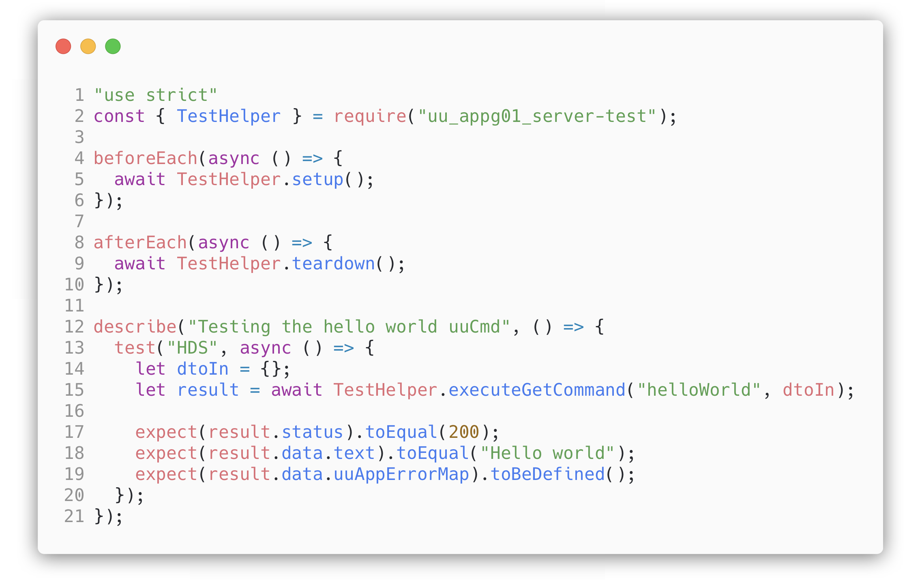
TestHelper
Helper class for writing tests
async setup(), async teardown()
async executeGetCommand(„useCase“, dtoIn)
More in uuAppServer-Node.js Documentation: Components | Testing
Copyright © 2016 Unicorn Top Gun Academy
Notes:
In case, that you need to initialize app -> TestHelper.initApp()

Slide 30
Exercise 3 – testing
Create test for exercise 2 (command joke/create)
into file <%sub-app%>/test/joke/joke.test.js
npm test -- joke.test.js
Copyright © 2016 Unicorn Top Gun Academy

Slide 31
Exercise 4 – debugging
Run the app in the debug mode
Process varies for each IDE.
You need to have a plugin installed to support Node.js
Open <%sub-app%>/app.js
JetBrains IDE – right click and select debug ‘app.js‘
VSCode – go / debug
Add a breakpoint to the controller created in exercise 2 and execute the uuCmd joke/create
Explore the ucEnv variable
Copyright © 2016 Unicorn Top Gun Academy

Slide 32
Abl
Located in <%sub-app%>/app/abl
It contains the business logic of the application
It is usually implemented based on the scenario described in the design
DtoIn validation
Error Handling
Interaction with DAO layer (persistence)
…
Copyright © 2016 Unicorn Top Gun Academy

Slide 33
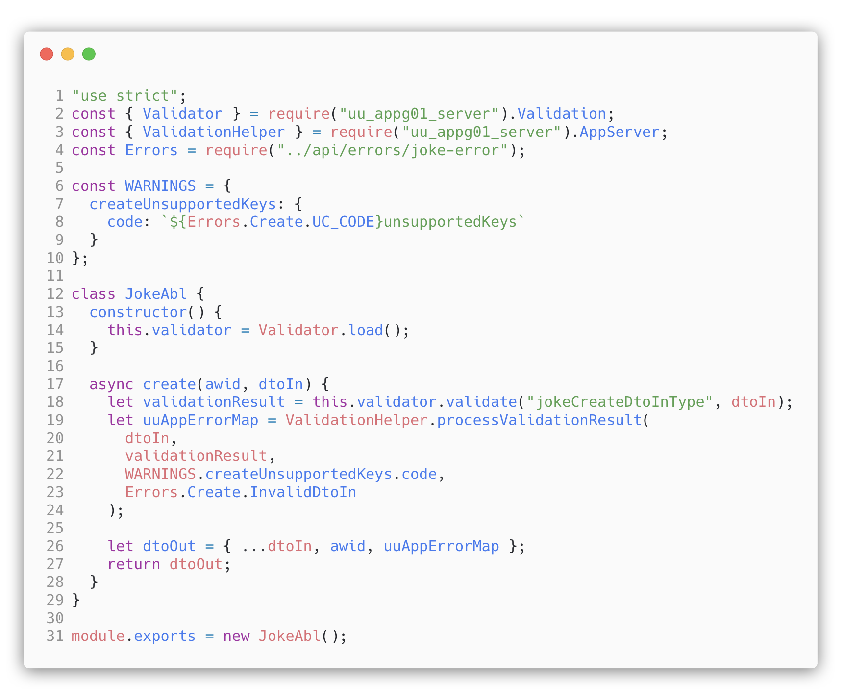
Abl
Copyright © 2016 Unicorn Top Gun Academy

Slide 34
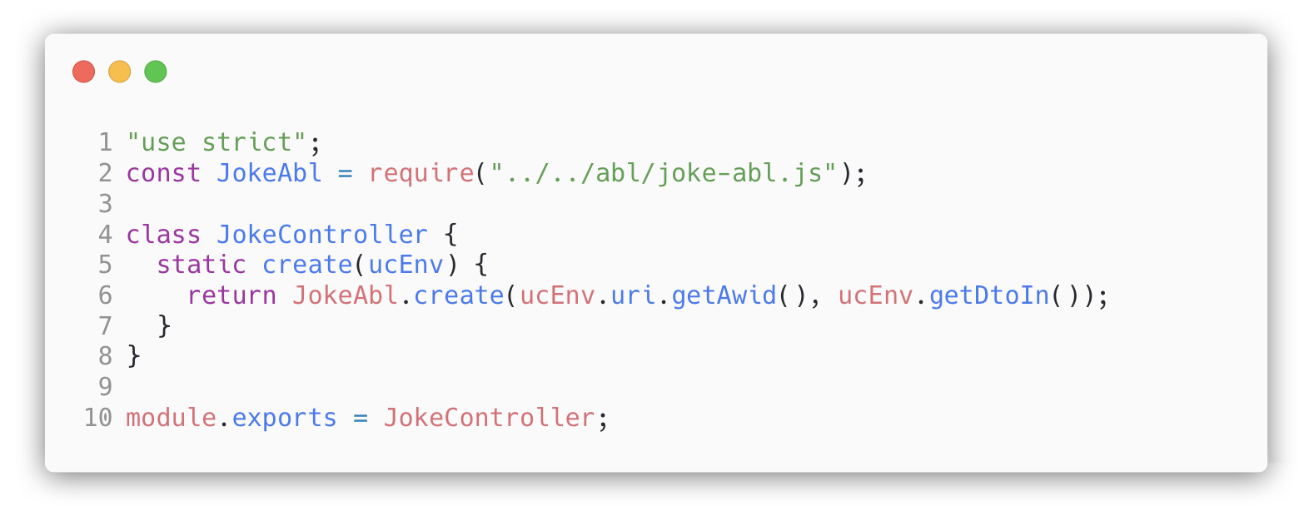
Abl – usage in Controller
Copyright © 2016 Unicorn Top Gun Academy

Slide 35
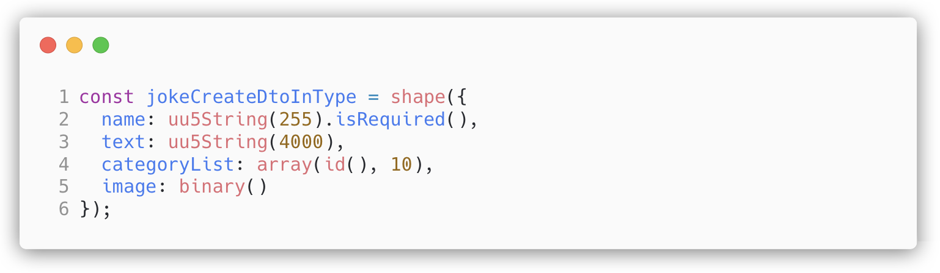
Validation – validation type
For each dtoIn, there is a matching validation type in an application
They are located in <%sub-app%>/app/api/validation_types
Validation type defines the content of dtoIn
What parameters to include
What data type these parameters should be
What parameters are required
Example of data types: shape, string, number, code, binary
See the general documentation for a complete list of data types
uuAppServer – Concepts | Validation
Copyright © 2016 Unicorn Top Gun Academy

Slide 36
Exercise 5 – validation types
Explore the basic data types that uuAppServer provides
Build a validation type for a book:
The book contains basic attributes such as:
Name – 100 characters maximum, required
Genre – one of: action, drama, horror
It also contains composite data types
Author(name, birthday) - required
Publisher (name, address)
Copyright © 2016 Unicorn Top Gun Academy

Slide 37
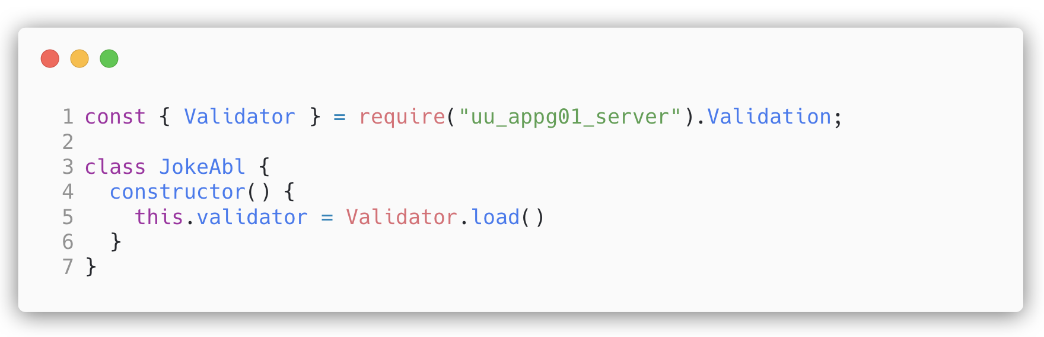
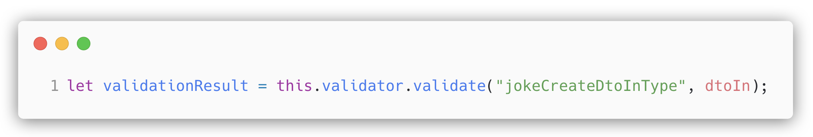
Validation – validation process
Validator initialization
Perform validation
Copyright © 2016 Unicorn Top Gun Academy

Slide 38
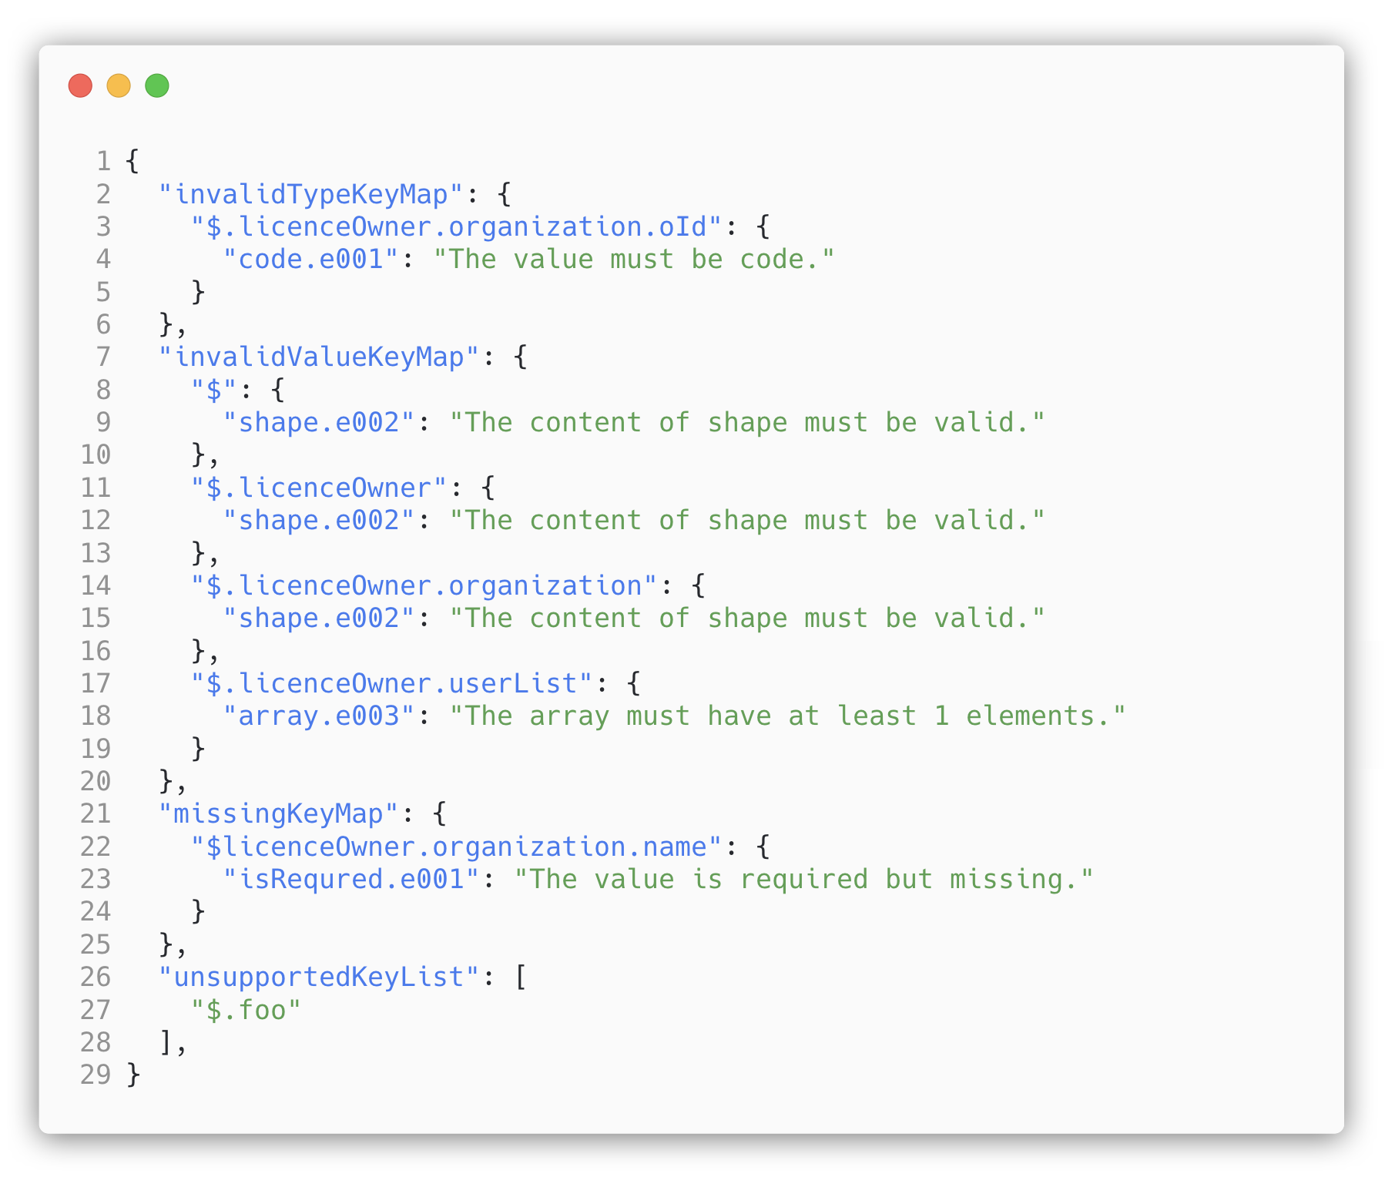
Validation – validationResult
Provides an API
IsValid(), getUnsupportedKeys(), getMissingKeys(), getInvalidValueKeys(), getInvalidTypeKeys(), getValidationErrorMap() ...
Copyright © 2016 Unicorn Top Gun Academy

Slide 39
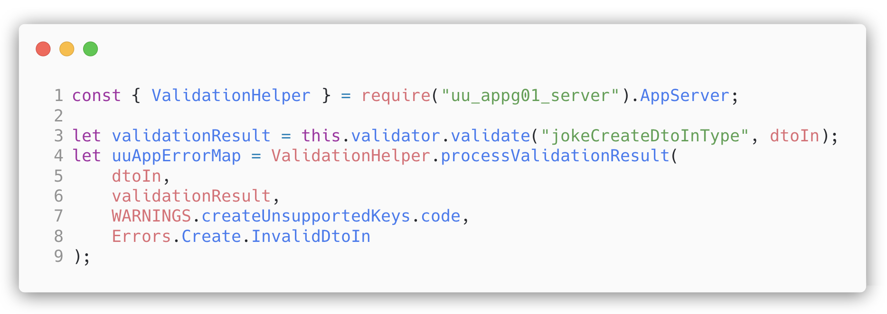
Validace – validationHelper
Automatic conversion of data types
Removes unsupported keys and adding a warning messages
Throws an exception in the case of an invalid dtoIn
Copyright © 2016 Unicorn Top Gun Academy

Slide 40
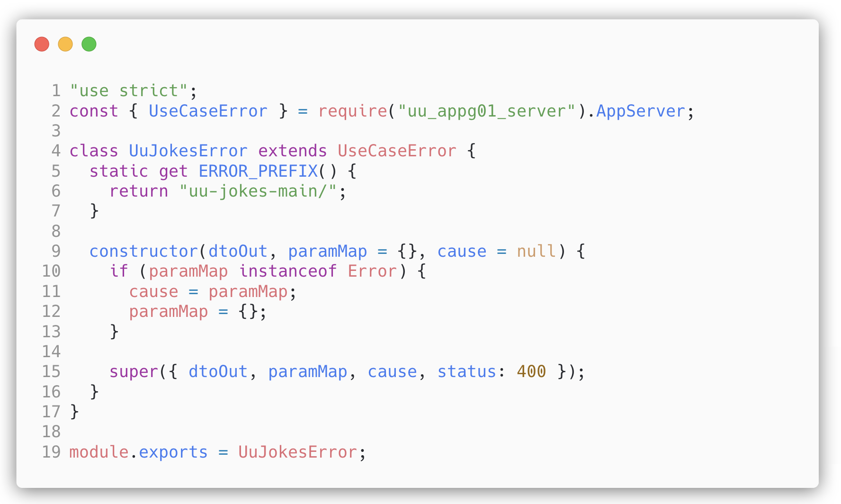
Error Handling - AppError
Abstract application exception
Parent for all application errors
Located in <%sub-app%>/app/api/errors
Copyright © 2016 Unicorn Top Gun Academy

Slide 41
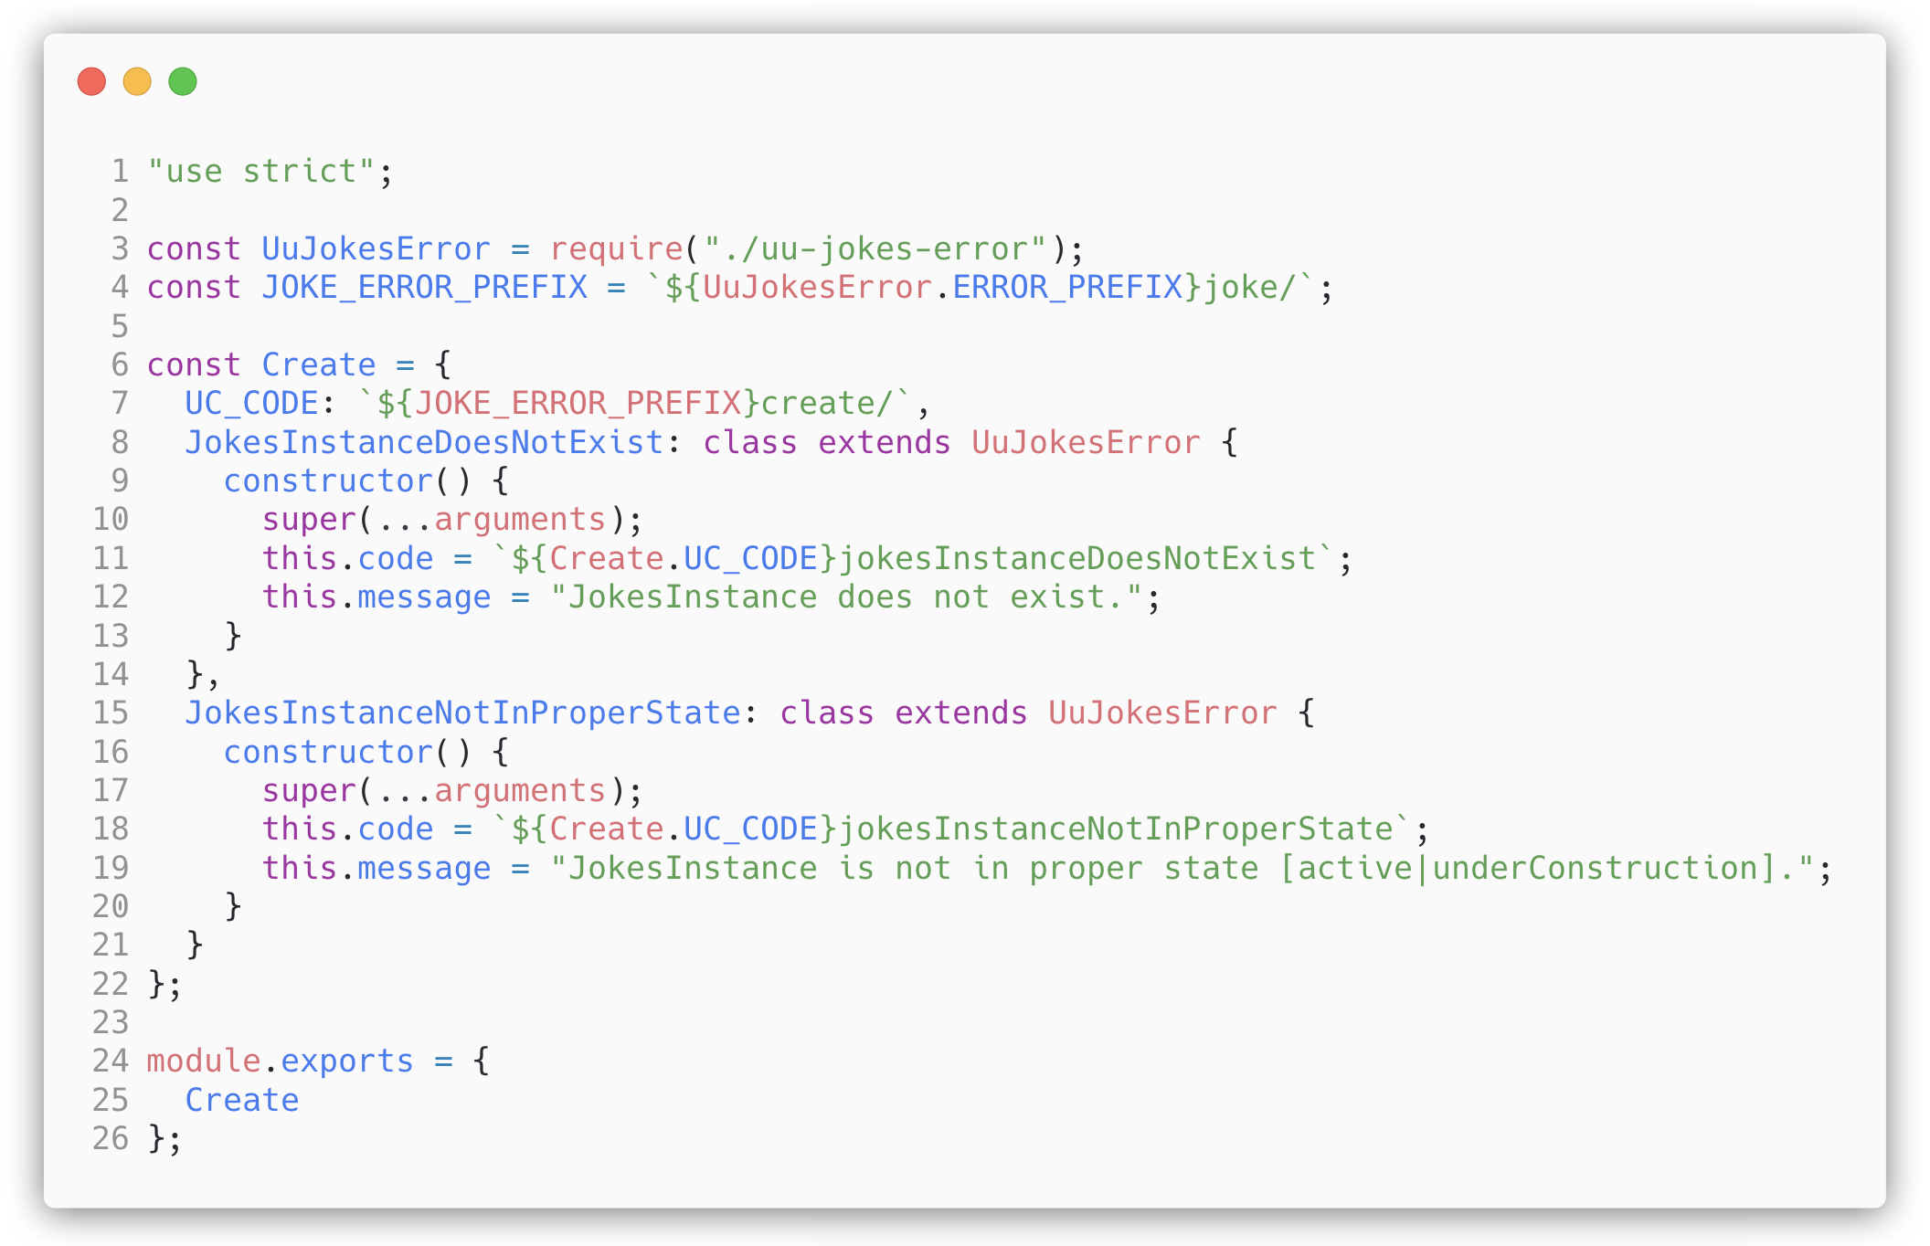
Error Handling – UseCase specific error
A specific application error that is ejected from the Abl
Code, message and situation for throwing error are defined in the design
Inherits from the AppError
Copyright © 2016 Unicorn Top Gun Academy

Slide 42
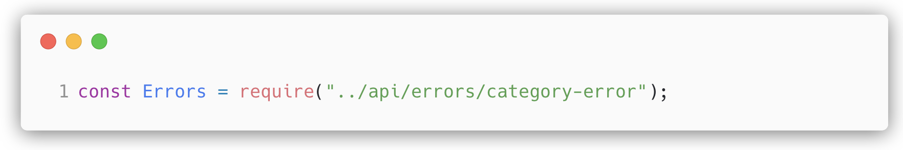
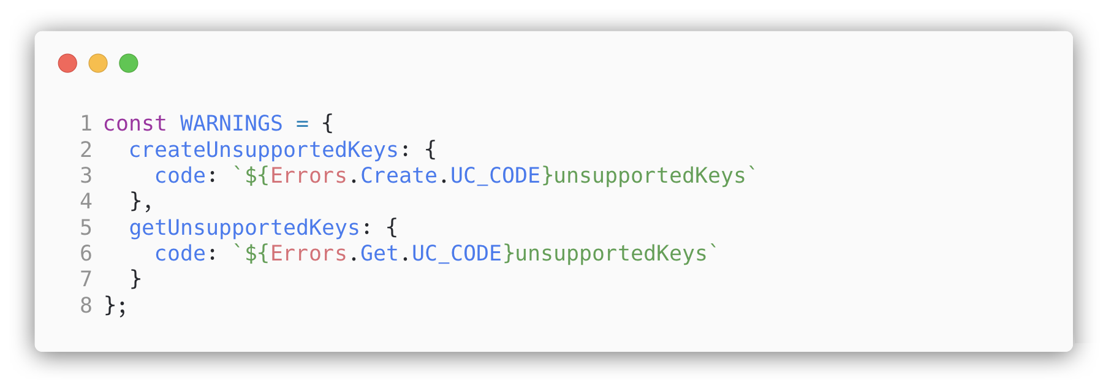
Error Handling in Abl
Require errors
Defining constants with warning codes
The warnings are also described in the design
A typical example of a warning is unsupportedKeys
Copyright © 2016 Unicorn Top Gun Academy

Slide 43
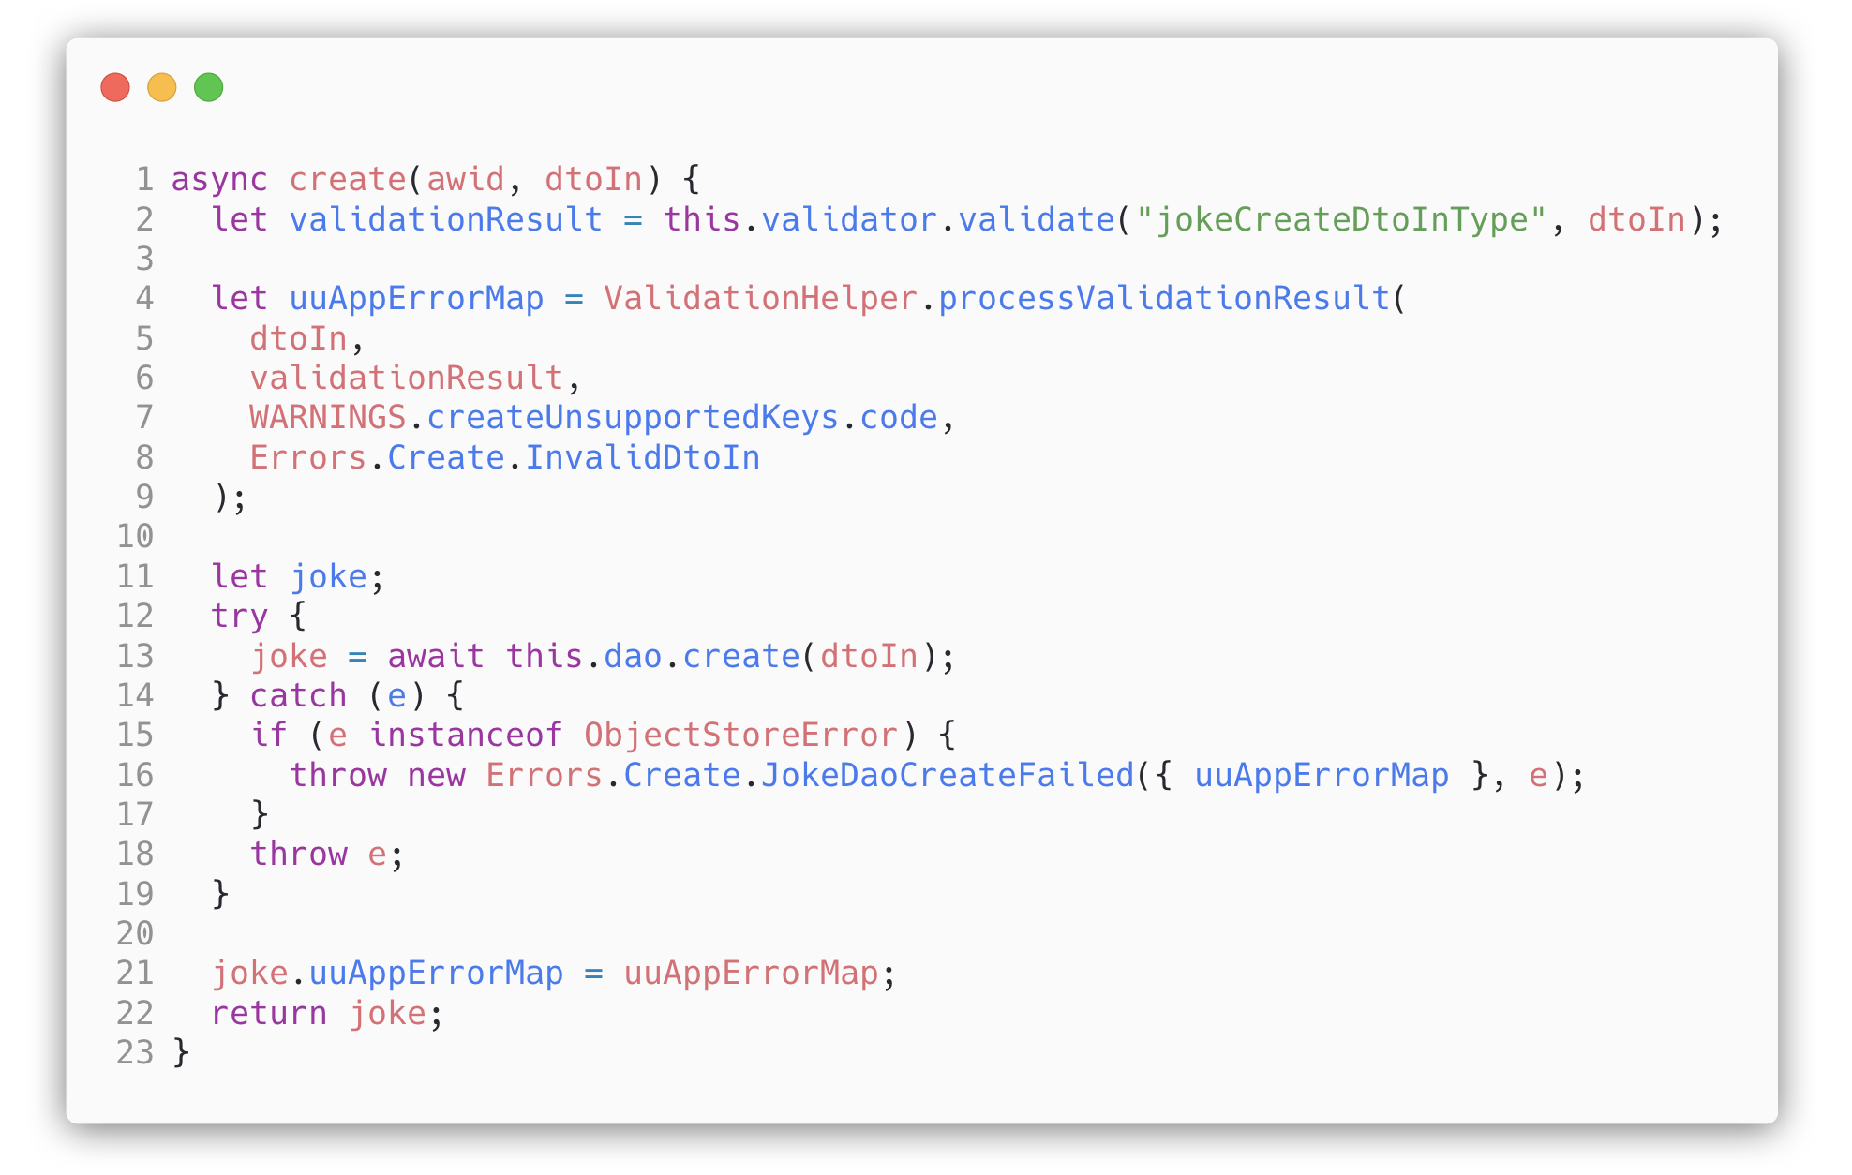
Error Handling in Abl
Use defined errors -> throw exceptions
Copyright © 2016 Unicorn Top Gun Academy

Slide 44
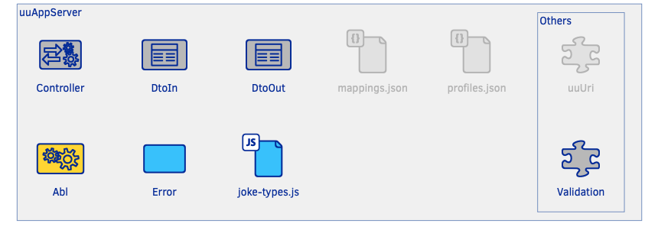
Exercise 6 – Abl, validation, errors
Specification in uuAppServer Node.js documentation | get started | example 2
Abl
DtoIn validation
Error handling
Copyright © 2016 Unicorn Top Gun Academy

Slide 45

Persistence - MongoDB
https://docs.mongodb.com/manual/
https://www.tutorialspoint.com/mongodb/index.htm
https://www.tutorialspoint.com/mongodb/mongodb_quick_guide.htm
Basic concepts
Comparison with RDBMS
Data Modeling, Data Types
CRUD
Sort
Indexing
Copyright © 2016 Unicorn Top Gun Academy

Slide 46
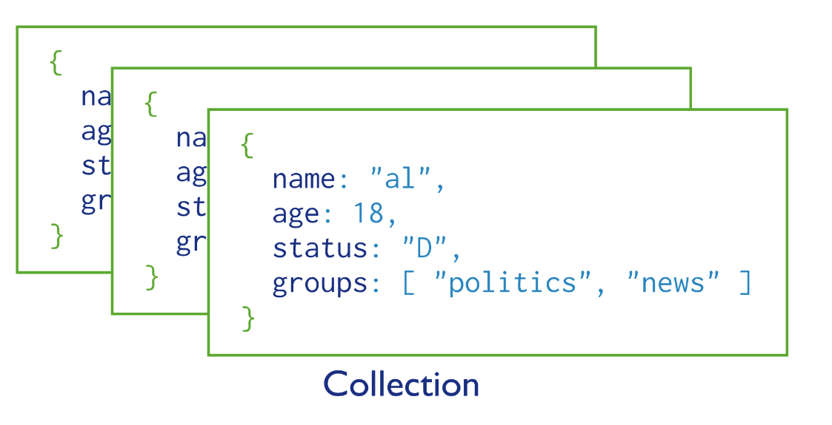
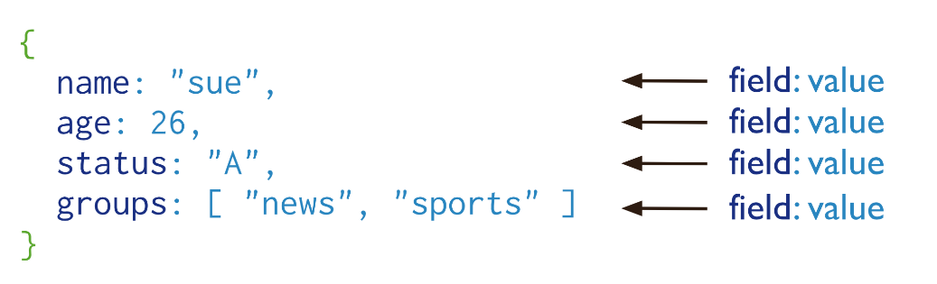
Persistence - MongoDB
NoSQL database
Basic concepts
Database, Collection, Document, field
BSON format
maximum document size 16MB
Copyright © 2016 Unicorn Top Gun Academy

Slide 47
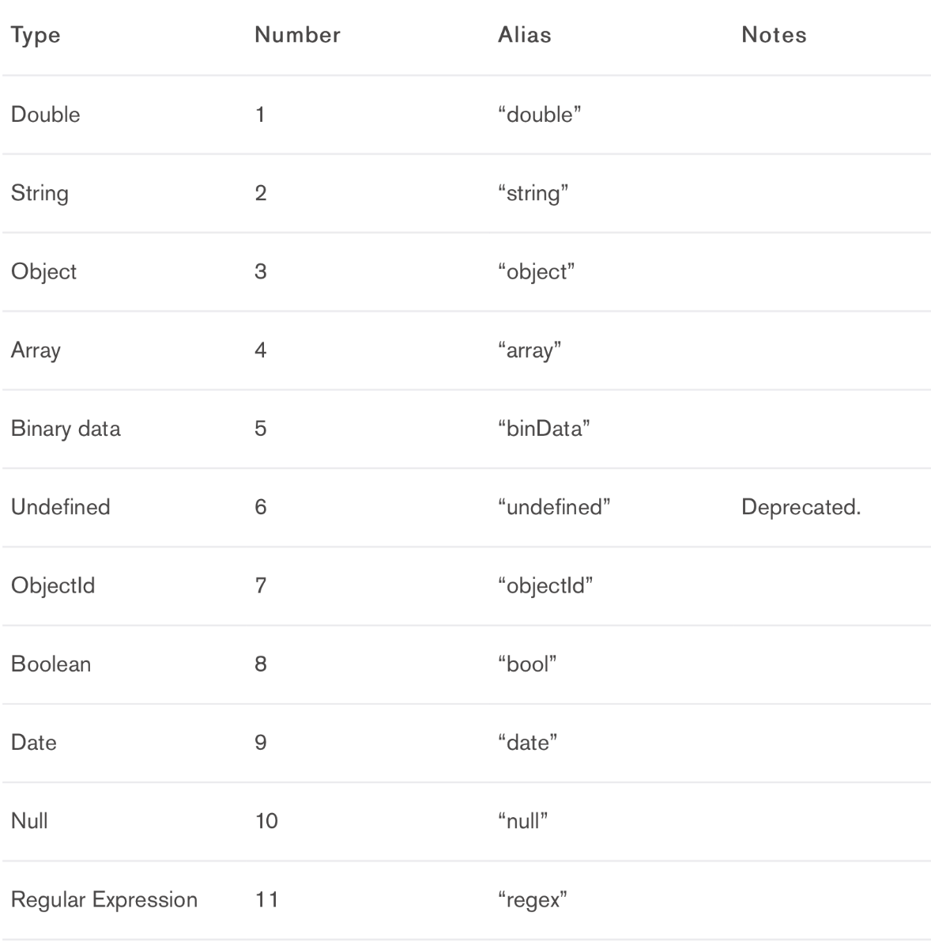
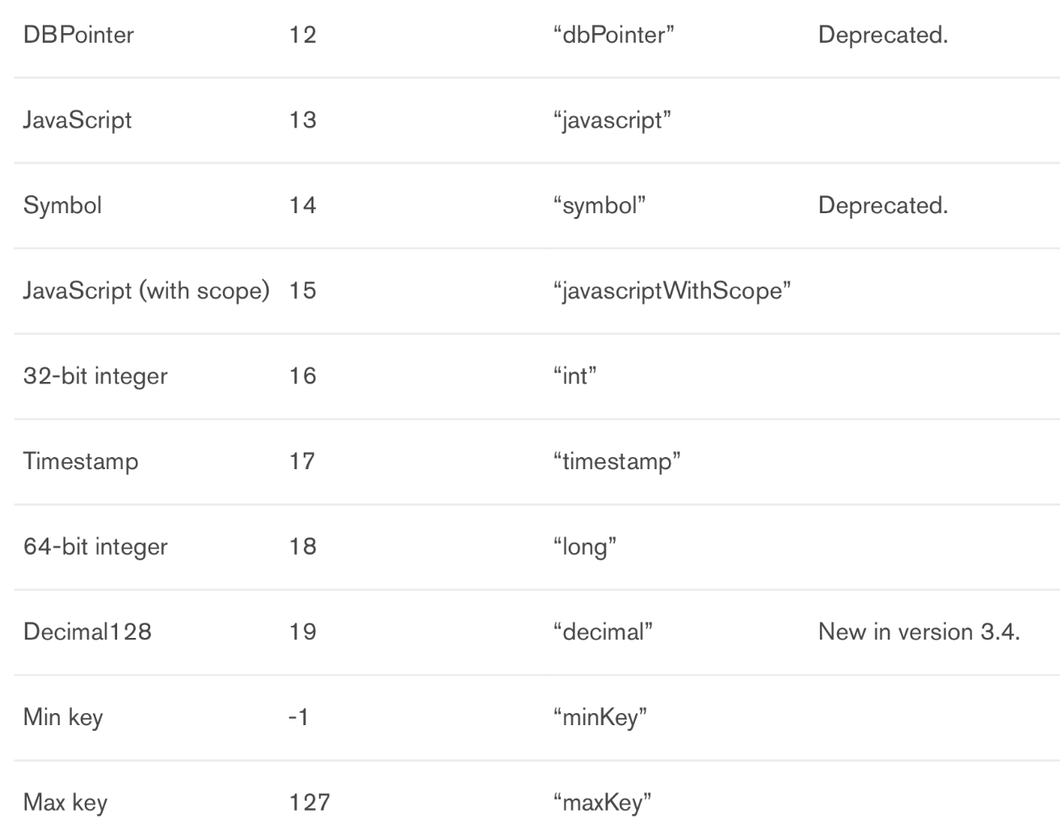
MongoDB – data types
Similarity to data types in JavaScript
Copyright © 2016 Unicorn Top Gun Academy

Slide 48
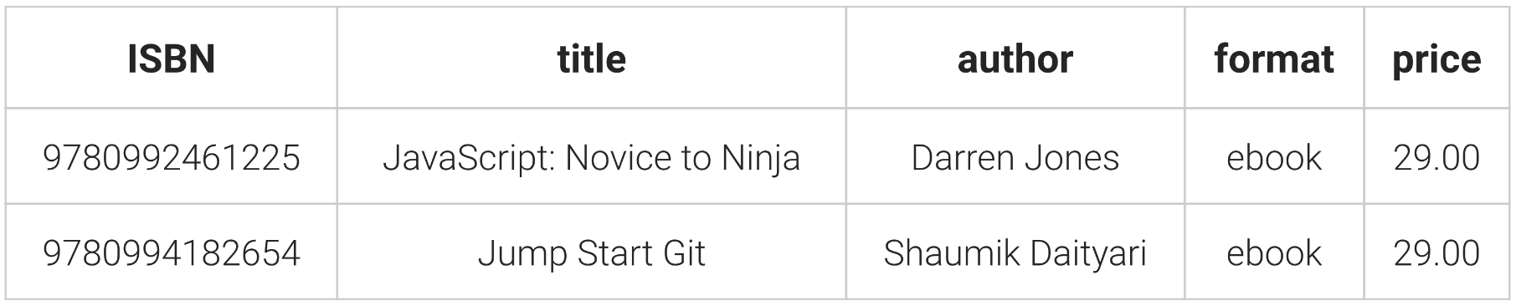
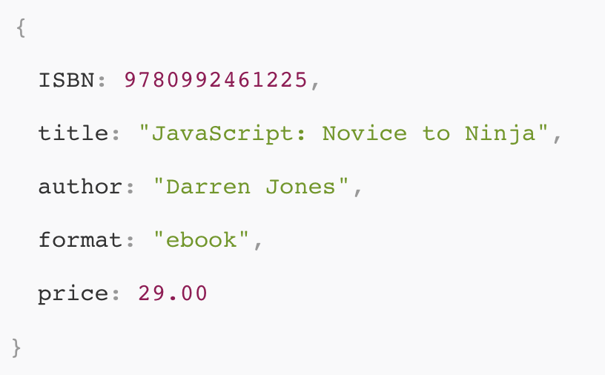
Comparison with RDBMS
NoSQL does not replace SQL
they are mutual alternatives
Records in tables vs. documents in collections
Copyright © 2016 Unicorn Top Gun Academy

Slide 49
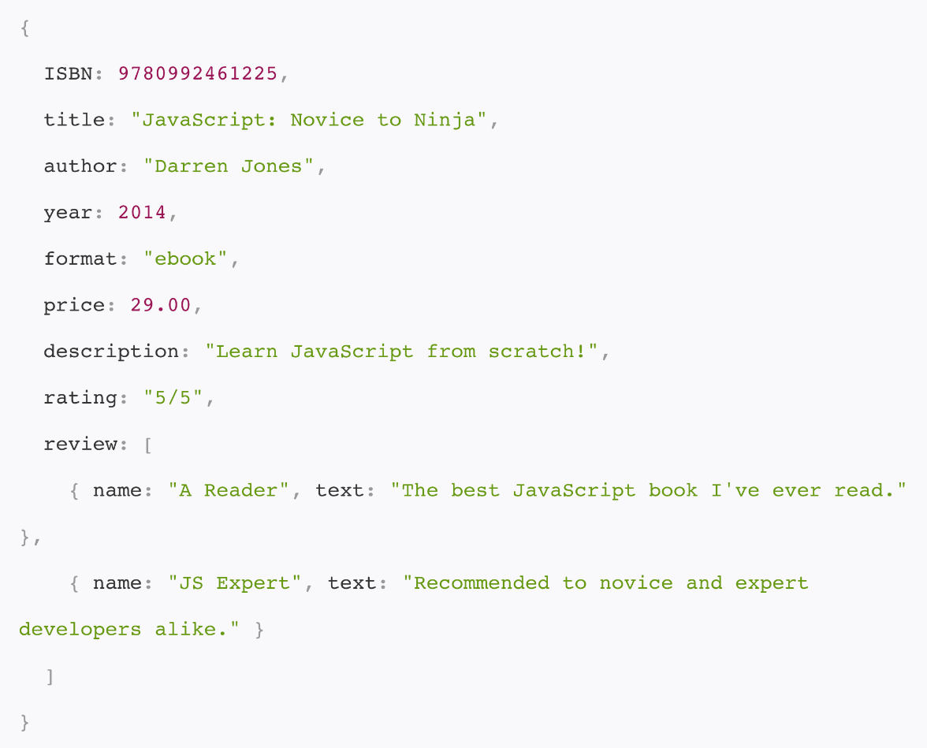
Comparison with RDBMS - Schemes
SQL
It is necessary to define
All records must follow the same schema within the table
NoSQL
Documents can be added at any time
Collections are automatically created
_id
Documents do not have to have the same structure
Copyright © 2016 Unicorn Top Gun Academy

Slide 50
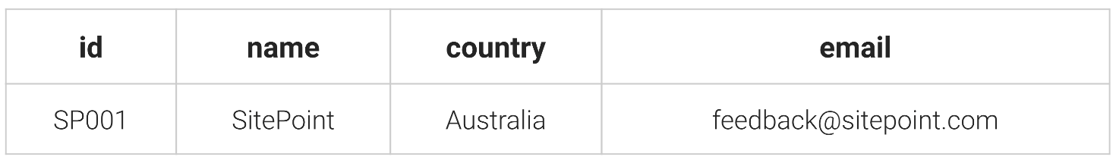
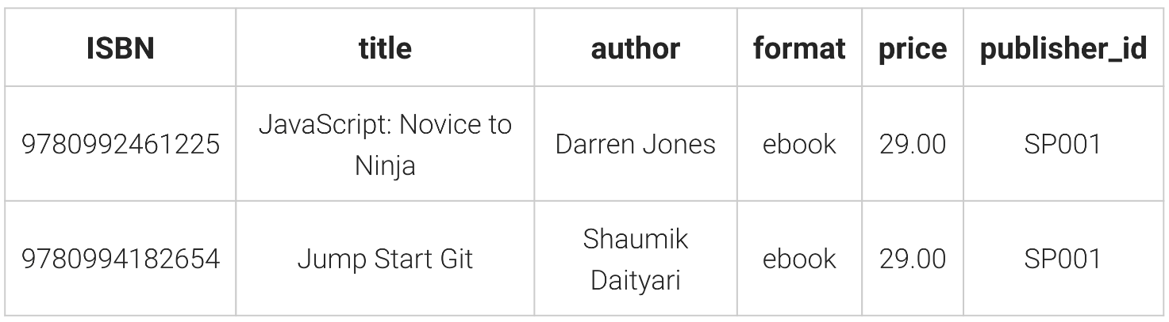
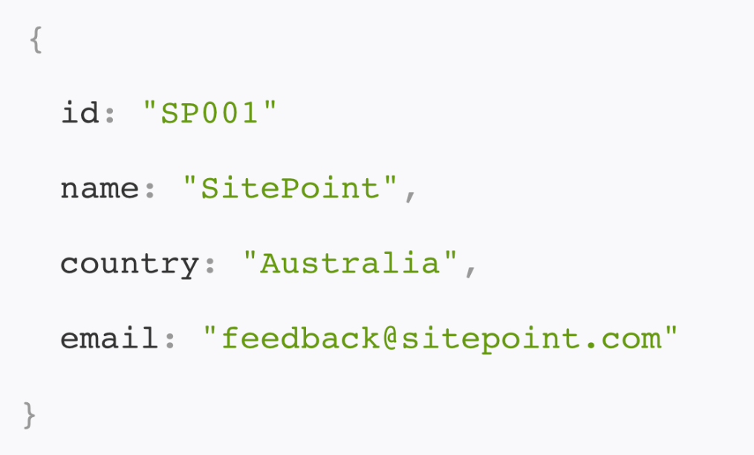
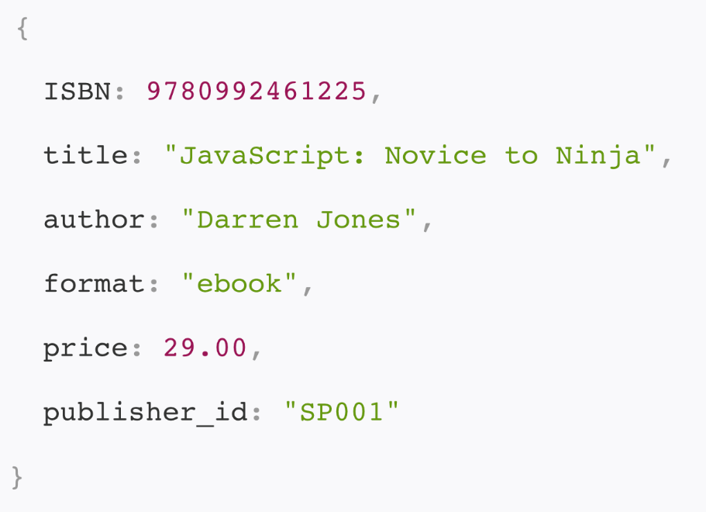
Comparison with RDBMS - Normalization
Table publisher
Minimizing redundant data
Copyright © 2016 Unicorn Top Gun Academy

Slide 51
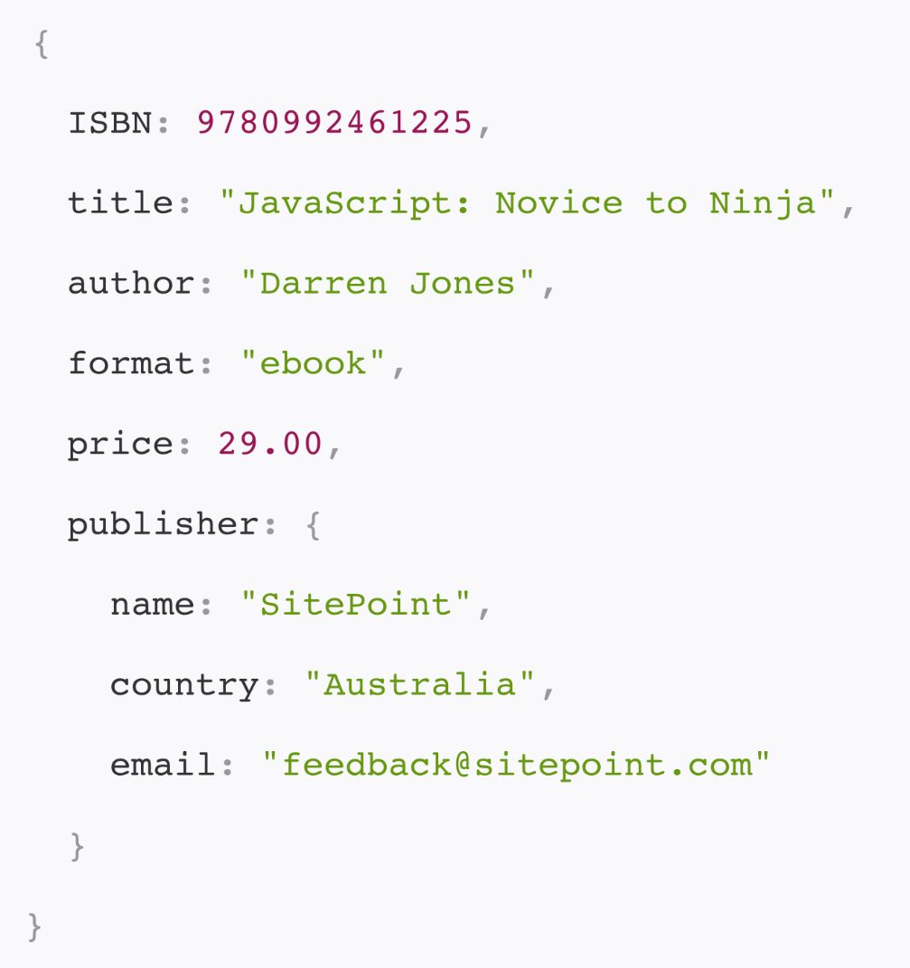
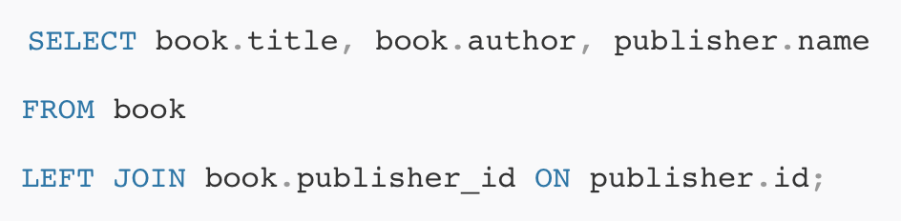
Comparison with RDBMS - Denormalization
There is no JOIN equivalent in NoSQL (need to solve in program logic)
The data is typically stored in a denormalized form
Copyright © 2016 Unicorn Top Gun Academy

Slide 52
Comparison with RDBMS
Data integrity
Foreign keys -> embedded document
Transaction
editing one document is atomic
MongoDB 4.0
Performance
10x faster (JOIN is slow in SQL)
Scalability
vertical and horizontal
Copyright © 2016 Unicorn Top Gun Academy

Slide 53
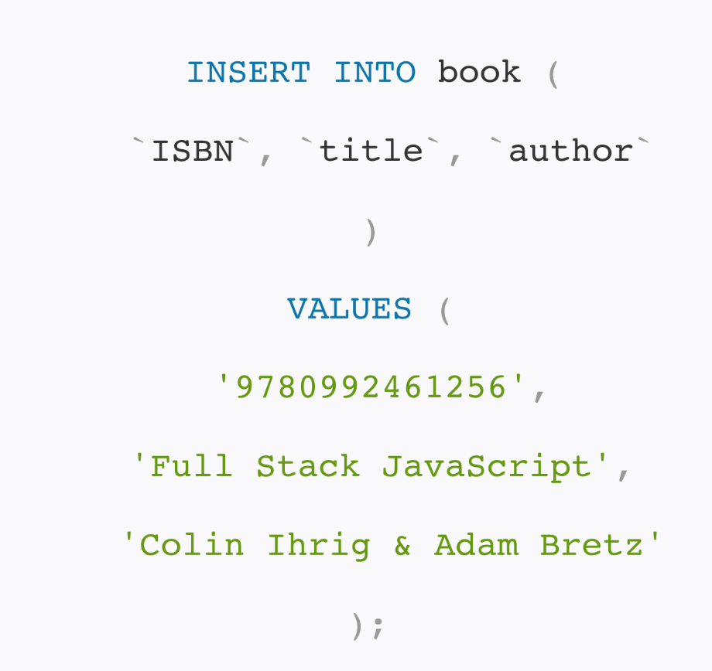
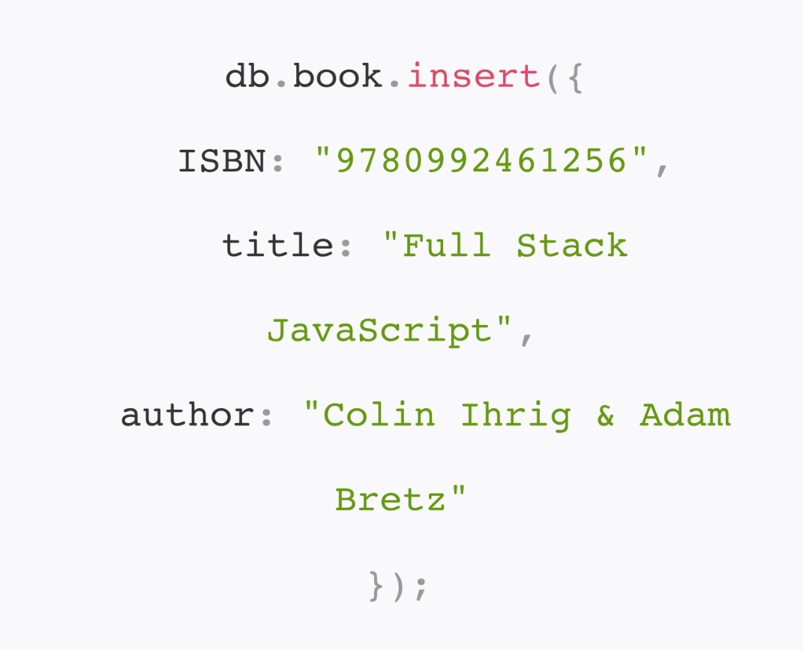
Comparison with RDBMS – CRUD create
Copyright © 2016 Unicorn Top Gun Academy

Slide 54
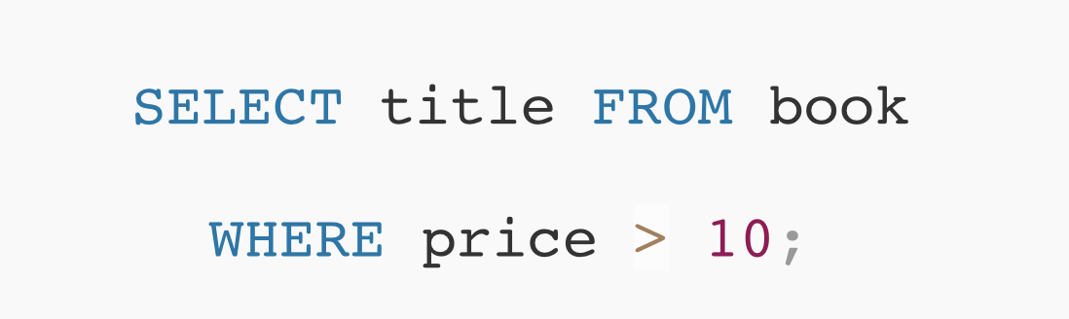

Comparison with RDBMS – CRUD read
$gt
Copyright © 2016 Unicorn Top Gun Academy

Slide 55


Comparison with RDBMS – CRUD update
Copyright © 2016 Unicorn Top Gun Academy

Slide 56


Comparison with RDBMS – CRUD delete
Copyright © 2016 Unicorn Top Gun Academy

Slide 57

MongoDB – indexes, sorting
It limits the number of documents to be searched
Collection scan
Copyright © 2016 Unicorn Top Gun Academy

Slide 58
MongoDB – indexes
db.COLLECTION_NAME.createIndex({KEY:1})
An index can be composed of multiple keys
db.mycol.createIndex({"title":1,"description":1})
Applies when searching by title, title and description. But not only when searching by description!
Attribute Unique
db.mycol.createIndex({"title":1}, {“unique“:true)
Ensures record uniqueness in particular collection
Index cannot be created if documents in db already violate uniqueness
Copyright © 2016 Unicorn Top Gun Academy

Slide 59
Exercise 7 - MongoDB
Connect to a locally running database in the terminal
create a JokesDb database
create a jokes collection
Add at least 3 documents to the collection
each will have a name, code, text, category (array of strings)
create an index on code that must be unique
create find for listing:
sorted by code (sort)
only first two results (limit)
show only name and code (projection)
https://www.tutorialspoint.com/mongodb/index.htm
GUI for MongoDB : Robo 3T, MongoDB Compass
https://robomongo.org/
https://www.mongodb.com/products/compass
Copyright © 2016 Unicorn Top Gun Academy

Slide 60
Environment preparation - configuration of persistence and initialization of the application
Configuration of primary uuSubAppDataStore
Persistence.json, uuAppObjectStore type
Primary datastore must be configured if you want to work with persistence (system data is saved automatically)
When persistence is enabled, the application's authorization and runtime mode are automatically turned on
So far, we'll ignore authorization by configuring all uuCmd as Public
Runtime must be configured by initializing the application
Copyright © 2016 Unicorn Top Gun Academy

Slide 61
App Runtime Mode
The goal is to limit executable UCs to a set of so-called Privileged UCs that run over ASID and are listed in profiles.json
Designed primarily for service interventions such as data migration
Initializing the application will switch the application to standard mode
Privileged uuCmd sys/initApp
Only AsidOwner can execute it – must be defined in development.json
Documentation uuAppServer-Node.js | uuCmdList | sys/initApp
Application initialization is done only once. If you want to change the runtime to an already initialized application, use uuCmd sys/setAppRuntimeMode.
Copyright © 2016 Unicorn Top Gun Academy

Slide 62

Exercise 8 – app initialization
Configure the primary uuSubAppDataStore
persistence.json (leave schemaMap empty):
development.json – the connection string to db must be configured
If you start the server now, the new endpoints cannot be called
the application is in privileged mode
Follow the instructions in the documentation
Documentation uuAppServer Node.js | uuApp Project | uuApp Initialization (steps 1 and 2)
Get an authentication token
Call the sys/initApp endpoint to switch the application to standard mode
Copyright © 2016 Unicorn Top Gun Academy

Slide 63

Persistence
Library uuAppObjectStore
UuAppServer component (unlike uuAppBinaryStore)
Copyright © 2016 Unicorn Top Gun Academy

Slide 64
uuAppObjectStore – uuObject
Each uuObject is managed by its schema
Each scheme is identified by the following parts:
structure
limits
indexes
Dao methods (Data access object)
The data storage is then described:
schema diagrams (determine connections between schemas)
definitions of individual schemes
One storage is used to store system data - primary
Copyright © 2016 Unicorn Top Gun Academy

Slide 65

uuAppObjectStore - scheme
Required structure of every schema in uuAppObjectStore (uuObject)
Indexes
Described in design
Each index must contain awid
Limits
maxNoi
maxSoi
Copyright © 2016 Unicorn Top Gun Academy

Slide 66
uuAppObjectStore - DAO
DAO is shortcut for DataAccessObject - its purpose is to provide a persistent storage API
Located in <%sub-app%>/app/dao
Class names have a postfix Mongo and inherit from UuObjectDao
Access to methods to use persistence
insertOne, insertMany
findOne, find
findOneAndUpdate,
deleteOne,
createIndex
…
The complete API description is in the general design of uuAppServer Concepts | Persistence | uuAppObjectStore | chapter UuObjectDao class
Copyright © 2016 Unicorn Top Gun Academy

Slide 67

uuAppObjectStore - DAO
<%sub-app%>/app/dao/joke-mongo.js
Copyright © 2016 Unicorn Top Gun Academy

Slide 68

uuAppObjectStore – Persistence.json
Located in <%sub-app%>/app/config/persistence.json
Defines individual schemes, their limits and implementation (DAO class)
It also defines to which uuSubAppDataStore the schema belong
Accordingly, the corresponding connection string is used from the application configuration (for local development uses the ./env/development.json configuration)
Copyright © 2016 Unicorn Top Gun Academy

Slide 69

uuAppObjectStore – Abl
Copyright © 2016 Unicorn Top Gun Academy

Slide 70

Exercise 9 – uuAppObjectStore
Specification in uuAppServer Node.js documentation | Get started | example 3
Copyright © 2016 Unicorn Top Gun Academy

Slide 71
Exercise 10 – uuAppObjectStore
Extend the cmd joke/create from Example 6 with the code attribute
The attribute is required and is of type code()
Create a unique awid,code index
Indexes are created as par of the init command of the application
For simplicity, we can create indexes in the Abl constructor
If a duplicate joke is created, it throws an exception uu-jokes-main/joke/create/jokeNotUnique
In paramMap then write code that could not be created: {code: ..}
Create a new GET cmd joke/get
An input parameter of code, type code(), required
Cmd returns the corresponding joke from the database
If the joke does not exist in the database, it throws an exception uu-jokes-main/joke/get/jokeDoesNotExist
In paramMap then write c ode that was not found : {code: ..}
Copyright © 2016 Unicorn Top Gun Academy

Slide 72
Authentication and Authorization
Authentication is used to uniquely identify the user accessing the system. The goal of authentication is to ensure that the system knows exactly who it is communicating with
Realized using OpenID Connect protocol, uuOIDC component
Based on the token sent in the HTTP Authorization header
The result is a Session object stored on ucEnv
documentation uuAppServer-Node.js | Components | Authentication
Authorization means the process of verifying the access rights of a user entering the information system
It follows up authentication
Authorization is to verify that the user has permission to take the appropriate action (such as creating a new joke)
Implemented by the uuAppWorkspace library
The result is an AuthorizationResult object stored on ucEnv
documentation uuAppServer-Node.js | Components | Authorization
Copyright © 2016 Unicorn Top Gun Academy

Slide 73

Authorization – Profiles.json
Structure defining uuAppProfiles and their assignment to relevant use cases
<%sub-app%>/app/config/profiles.json
Privileged x Not privileged
Copyright © 2016 Unicorn Top Gun Academy

Slide 74
Authorization – uuAppWorkspace
Logical spaces that group objects into controllable entities
For example, imagine that we have an application that allows you to create e-learning courses where students can browse lessons, answer questions, and solve individual exercises and tests. The fact that a particular user has the ability to run a Faraday Cage test in the Physics for Housewives course is not logically related to the fact that same user should have the right to run the test for the Young Automechanics course. Simply the functionality is still the same - running the test, but the application spaces are different - the Physics for Housewives course and the Young Automechanics course.
Awid - uuAppWorkspace identifier (appWorkspaceId)
Command list documentation uuAppServer-Node.js | uuCMD List:
sys/initAppWorkspace
sys/setProfile
sys/createPermission
Copyright © 2016 Unicorn Top Gun Academy

Slide 75

Authorization - uuAppWorkspace
Copyright © 2016 Unicorn Top Gun Academy

Slide 76
Exercise 11 - Authentication & Authorization
Modify profiles.json in your application to have uuCMD joke/create with assigned the Authorities profile
Try to call the endpoint -> the uuAppWorkspace exception will be thrown
Initializing uuAppWorkspace & Configuring the Authorities Profile
Follow the instructions Documentation uuAppServer Node.js | uuApp Project | uuApp Initialization (steps 3 and 4)
student role ues:UCL-BT:TGA/ST~<uuIdentity>
Set Executives profile to the joke/get uuCmd
Try execute cmd - you won't have rights again.
Assign rights for the Executives profile, but this time not with sys/setProfile, but with sys/createPermission (see uuAppWorkspace uuCmd documentation)
Copyright © 2016 Unicorn Top Gun Academy

Slide 77
Exercise 12 – Authentication & Authorization
extend joke/create
The DB will store also the attribute author and uuIdentity, where the name and uuIdentity are of the user who joke created
ucEnv.getSession().getIdentity().getName() / getUuIdentity()
Edit the list of profiles for this UC to Public and Authorities
The state attribute will be stored in the db
If the command was called by a user who is in the Authorities profile, state will be set to active, otherwise it will be created in a pending state.
ucEnv.getAuthorizationResult().getAuthorizedProfiles()
BONUS: new command joke/setActive
Profile: Authorities
DtoIn: code
Sets joke to active.
Copyright © 2016 Unicorn Top Gun Academy

Slide 78

Authentication & Authorization Testing
If you assign a non-Public use case profile, the tests will not work.
This is because the tests also need to initialize the workspace and configure the profiles (just like when you call a use case from an Insomnia).
There are two ways to test :
The first, simpler way is to disable authentication and authorization in the tests:
The second option is to use the defined methods to initialize the workspace and configure the test users in the test.json configuration.
Documentation node.js | components | testing | reference documentation, chapter Integration tests of commands
Copyright © 2016 Unicorn Top Gun Academy

Slide 79
Persistence - binary data
Library uuAppBinaryStore
Data is managed in the form of specific elementary records
uuBinary
Each uuBinary is managed within its respective schema, which is described (as in the case of uuAppObjectStore):
Structure
Limits
Indexes
DAO methods
The data storage as a whole is then described:
schema diagrams (determine connections between objects as schema elements)
definitions of individual schemes
predefined uuCMDs vs custom DAO implementation
Copyright © 2016 Unicorn Top Gun Academy

Slide 80

uuAppBinaryStore - scheme
Required structure of every schema in uuAppObjectStore (uuObject)
uuAppBinaryStore is used to store unstructured data only, so uuBinary must not contain any additional parameters.
If necessary, additional attributes are stored in uuAppObjectStore, together with a reference to the associated uuBinary
Limits
MaxNoi, maxSoi, maxSob
Copyright © 2016 Unicorn Top Gun Academy

Slide 81


uuAppBinaryStore – predefined uuCMDs
Working with binary data is ensured by simple configuration dependency – <uuSubApp>-server/package.json
Configure MongoDB connection
<uuSubApp>-server/env/development.json for local development
Copyright © 2016 Unicorn Top Gun Academy

Slide 82

uuAppBinaryStore – predefined uuCMDs
Profiles – profiles.json
The uuCMDs are described in the general documentation of uuAppServer-Node.js | uuCMD List
Copyright © 2016 Unicorn Top Gun Academy

Slide 83

Exercise 13 – uuAppBinaryStore CMD
Configure the uuAppBinaryStore CMD in your application
Create a new uuBinary - createBinary
Download uuBinary - getBinaryData
Save the image and try parameterizing its download using the contentDisposition (inline | attachment) parameter
updateBinaryData
listBinaries (+ Apply paging and filters)
deleteBinary
Copyright © 2016 Unicorn Top Gun Academy

Slide 84
Exercise 14 – uuAppBinaryStore CMD
Implement your own cmd image/create
Within the logic of this cmd, just call the uuAppBinaryStore-cmd library
You do not need to implement dao, configure persistence.json, etc.
Use the logic implemented in the binarystore-cmd library, just call it from your own endpoint
Hints:
Create a new controller called ImageController
Require Abl
const binaryAbl = require(“uu_appg01_binarystore-cmd“).UuBinaryModel
In Abl, call the createBinary method and pass it awid and dtoIn
In the same way implement image/get
Response in this case is the object containing the Stream. It is therefore necessary to return dtoOut from the controller using the following method (because the stream is not just return): (remember to use await!)
ucEnv.setBinaryDtoOut(dtoOut)
Copyright © 2016 Unicorn Top Gun Academy

Slide 85
uuAppBinaryStore - DAO
DAO stands for DataAccessObject its only purpose is to provide a persistent storage API
Located in the folder <%sub-app%>/app/dao
Class names have a postfix Mongo and inherits from UuBinaryDao
Access to database methods
insertOne
findOne, find
findOneAndUpdate,
deleteOne,
createIndex
insertFromStream, openDownloadStream, updateFromStream
…
The full API description is within the general design uuAppServer Concepts | Persistence | uuAppBinaryStore | kapitola UuBinaryDao class
Copyright © 2016 Unicorn Top Gun Academy

Slide 86

uuAppBinaryStore - DAO
<%sub-app%>/app/dao/joke-image-mongo.js
Copyright © 2016 Unicorn Top Gun Academy

Slide 87

uuAppBinaryStore – Persistence.json
Same configuration principle as uuAppObjectStore
Copyright © 2016 Unicorn Top Gun Academy

Slide 88

uuAppBinaryStore – Controller
If uuCMD returns binary data, it is necessary to use the setBinaryDtoOut() method on ucEnv to pass it in the controller.
The method ensures correct headers setting (Content-Type, Content-Length and Content-Disposition)
Copyright © 2016 Unicorn Top Gun Academy

Slide 89

uuAppBinaryStore – Abl
Copyright © 2016 Unicorn Top Gun Academy

Slide 90

uuAppBinaryStore – Abl
Copyright © 2016 Unicorn Top Gun Academy

Slide 91

Exercise 15 – uuAppBinaryStore DAO
Specification in the uuAppServer Node.js documentation | Get started | example 7
Copyright © 2016 Unicorn Top Gun Academy

Slide 92


uuUVE
Build the client part
cd uu_demoappg01_main-client; npm install; npm run build
This creates a client build into the folder <%sub-app%>-server/public/
UVE definition v mappings.json
http://localhost:8080/uu-jokes-maing01/.../home
The client build is executed automatically by uuDevKit during the “npm start” in the server project, if the naming conventions are followed.
Copyright © 2016 Unicorn Top Gun Academy

Slide 93

uuUVE
DefaultUve
special endpoint called defaultUve (configured the same way as home from previous slide)
DevaultUve ensures that the client is available at all endpoints defined within the client application. So home, about, jokes etc.
The second option is to list all these endpoints manually in mappings.json
Copyright © 2016 Unicorn Top Gun Academy

Slide 94
Exercise 16 – joke/list
Implement the joke/list uuCMD (test), see example 5
GET, returns a list of all jokes on that AWID
Implement only getting all jokes, without having to filter by using the visibility attribute as described in the example.
BONUS:
Extend dtoIn with the state attribute
Validation type oneOf(“active“, “pending“)
If state is not specified, it lists all jokes
If specified, it lists only jokes with the specified state
+ Sort the command output by creation date, descending
BONUS 2:
implement joke/delete uuCmd
GET, deletes the joke based on the input parameter code
Copyright © 2016 Unicorn Top Gun Academy

Slide 95


Logging
When debugging an application, use logger instead of console.log
Several levels of message importance
DEBUG < INFO < WARN < ERROR < FATAL < UNKNOWN < OFF
Logger usage:
Log Level configuration
Copyright © 2016 Unicorn Top Gun Academy

Slide 96


uuAppClient
The library is used to call uuCMD of other uuApp.
POST & GET
uuUri
dto
Authentication
Error Handling
Example:
Copyright © 2016 Unicorn Top Gun Academy

Slide 97
uuAppClient
More in documentation uuAppServer – Node.js | Components | uuAppClient
Headers
Authentication
Interceptors for HTTP request processing
Download and upload binary data
Error handling
Copyright © 2016 Unicorn Top Gun Academy

Slide 98
uuAppDevkit
Documentation uuAppDevkit
Tasks
Copyright © 2016 Unicorn Top Gun Academy

Slide 99
Exercise 17 - uuAppClient
Implement uuCmd (get) getPageInfo, its input parameter will be the code attribute (validation type code()).
In the Abl of this uuCmd, call endpoint loadPage of any uuBookKit book deployed in the cloud send the code parameter from the input (= page code)
For example. AppServer-Node.js documentation, example 1: https://uuos9.plus4u.net/uu-bookkitg01-main/78462435-2590bf997d264d959b9d6a88ee1d0ff5/loadPage?code=example01
it returns json with information about the page, which you then return to output
Use uuAppClient to call, don't forget to send a session!
Bonus:
Allow URI (without use case loadPage) to configure in application configuration (development.json)
Load from configuration using Config component
Documentation Node.js | Components | Cofiguration | Reference Guide
Build the resulting URI using the UriBuilder module
Documentation Node.js | Components | Routing | Reference Guide
Copyright © 2016 Unicorn Top Gun Academy

Slide 100
uuCloud deployment
The uuDevKit library provides a set of npm tasks for deployment
npm run package
npm run uuAppBox
npm run uuCloudDeploy
npm run uuCloudShare
=> npm run deploy – runs all previous tusks
Project configuration
– resources: asid, awid, asidOwner, osid
/uu_jokes_maing01-server/env/uucloud-development.json
/uuapp.json
Version
You cannot redeploy an application with the same version!
The solution is to add a suffix after the version, 1.1.0-dev.
it adds timestamps for uniqueness
Documentation of uuAppServer-Node.js | Deployment, Operation | Deployment to uuCloud
Copyright © 2016 Unicorn Top Gun Academy

Slide 101
Exercise 18 – uuCloud deployment
Download the course attachment uucloud-development.json (add it to server/env/)
Modify the file according to the resources on the training portal env/uucloud-development.json
uuSubApp.code – modify the code to include your identifier for example „TGA.JOKES124701.MAING01" – so that everyone has a unique instance of the app. No dashes (will be part of the uri)
uuSubAppInstance – fill in the following:
asid, asidOwner
awidList.awid, awidList.awidOwner
Osid, bsid
Configure the path to the folder where uuAppBox should be created
uuapp.json => appBoxLocationUri: "ues:TGA-BT:UAD201911-01/12-470-1„
+ Change the project version x.x.x-dev (to ensure a possible redeploy with the same version)
Run deploy: npm run deploy (eventually these scripts: package, uuAppBox, uuCloudDeploy, uuCloudShare)
> https://uuos9.plus4u.net/tga-jokes<uuIdentity>-maing01/<awid>/
Copyright © 2016 Unicorn Top Gun Academy
Notes:
modify the application code to include your identifier

Slide 102
Exercise 19 - uuJokes
Discover the design of uuJokes
Helpdesk | uuKnowledgeBase | Design uuJokesg01
What would you implement first?
Implement 2 chosen use cases
All layers
Controller
Abl
DAO
Do not forget to implement validation, Error Handling, all alternative scenarios and tests
Compare your implementation with the real one related git referred to in the design
Copyright © 2016 Unicorn Top Gun Academy

Slide 103
Copyright © 2016 Unicorn Top Gun Academy

